Slide 1
Meet Nadina, she’s a chemical design engineer
This project has received funding from the European Union’s Horizon 2020 research and innovation programme under grant agreement No 665100.

Slide 2
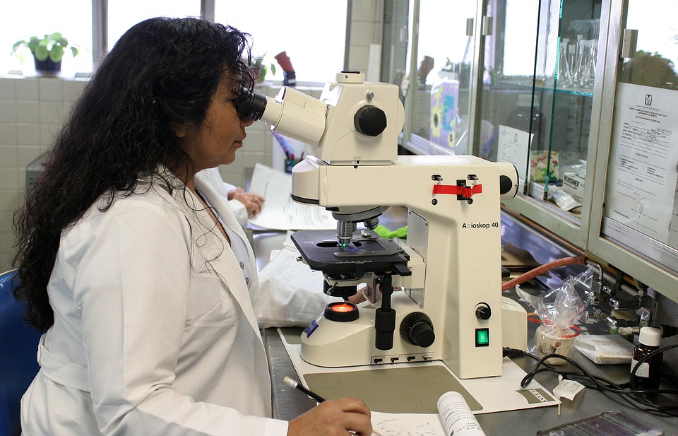
Meet Nadina, she’s a chemical design engineer
In school Nadina studied Maths and Chemistry for A-level.
After school she did an apprenticeship in an engineering firm and then received a bursary to study in chemical engineering in University.
She wanted to get a job in the sport industry because she wanted to do something related to people’s health
She designs products and accessories to help people with sport injuries.
This project has received funding from the European Union’s Horizon 2020 research and innovation programme under grant agreement No 665100.

Slide 3
What skills help me as an engineer?
“My job requires a lot of hands-on, practical experience. I also need an understanding of innovation principles and processes as well as how design can help attract people to a product as well as how the design help’s people get benefit from a product.”
“As a chemical design engineer I work with raw materials to create everyday, useful products to help people with sporting injuries. For a job like mine you would need to be interested in chemistry. There are also plenty of routes into engineering – such as apprenticeships and vocational schemes – that focus more on your experience of practical problem-solving rather than a more academic route.”

Slide 4
Chemical Design Engineer
Main aspects of Nadina’s job:
Identify a common problem to create a ‘life hack’ e.g. how to minimise the impact of a sport injury with quick treatment using specialist products.
Generate potential solutions by testing chemicals, materials and using principles of ergonomic design.
Compare and evaluate solutions by rigorous lab testing to find the best fit solution for a particular injury.
Consider risks to society with thorough testing and the environment by identifying environmentally friendly resources.

Slide 5
Chemical Engineering
You are a group of chemical engineers who work for a sports company. As part of your role, you design products that minimise sports injury. Your latest task is to design two instant sports injury packs:
One pack needs to provide immediate relief for a sports injury that has just occurred. It needs to sooth pain and reduce swelling.
One pack needs to provide relief for an old sports injury. It should be able to sooth a dull ache.

