Slide 1

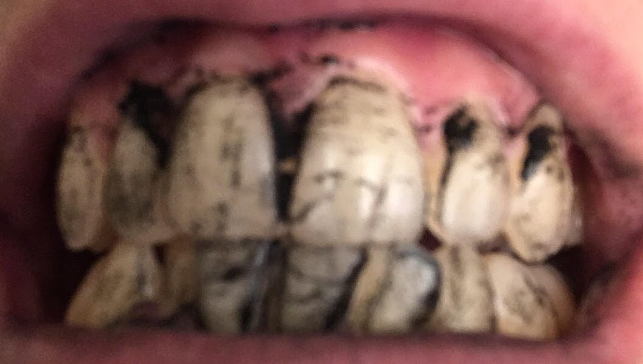
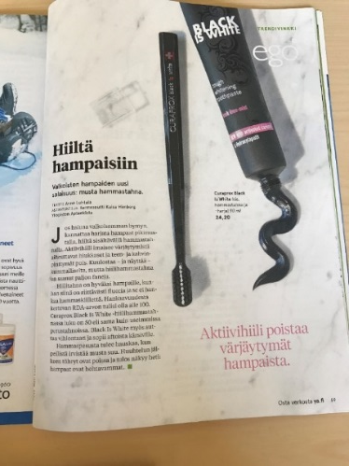


Coal to the teeth
This project has received funding from the European Union’s Horizon 2020 research and innovation programme under grant agreement No 665100.

Slide 2
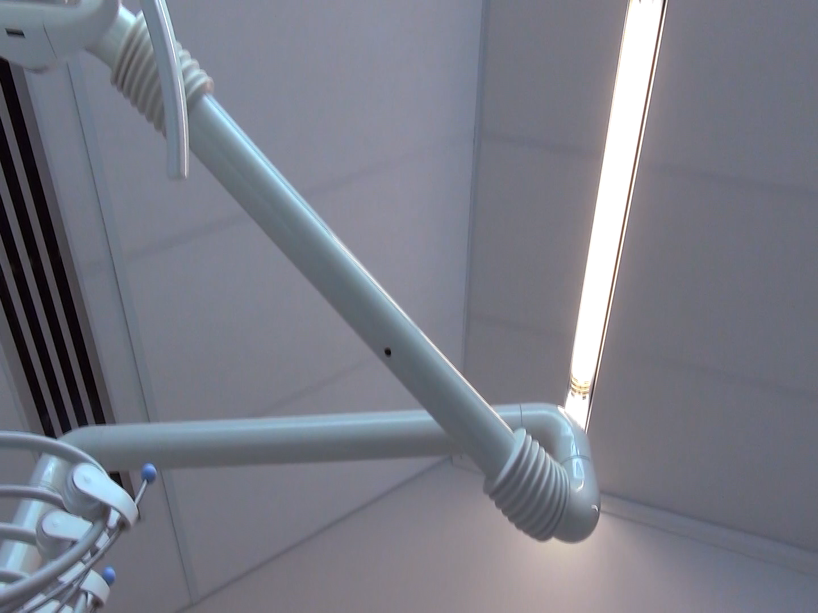


Slide 3
Dentist’s notes
Routine dental check-up. 1 cavity and 3 teeth with damaged enamel. Patient mentions yellow teeth and says to be ashamed when smiling. Patient asks if a new product called Coal toothpaste can be used in teeth whitening. There is no sufficient knowledge provided and further laboratory tests are requested.
New appointment for next week to treat the cavity and give information about dental care and different teeth whitening methods.

Slide 4
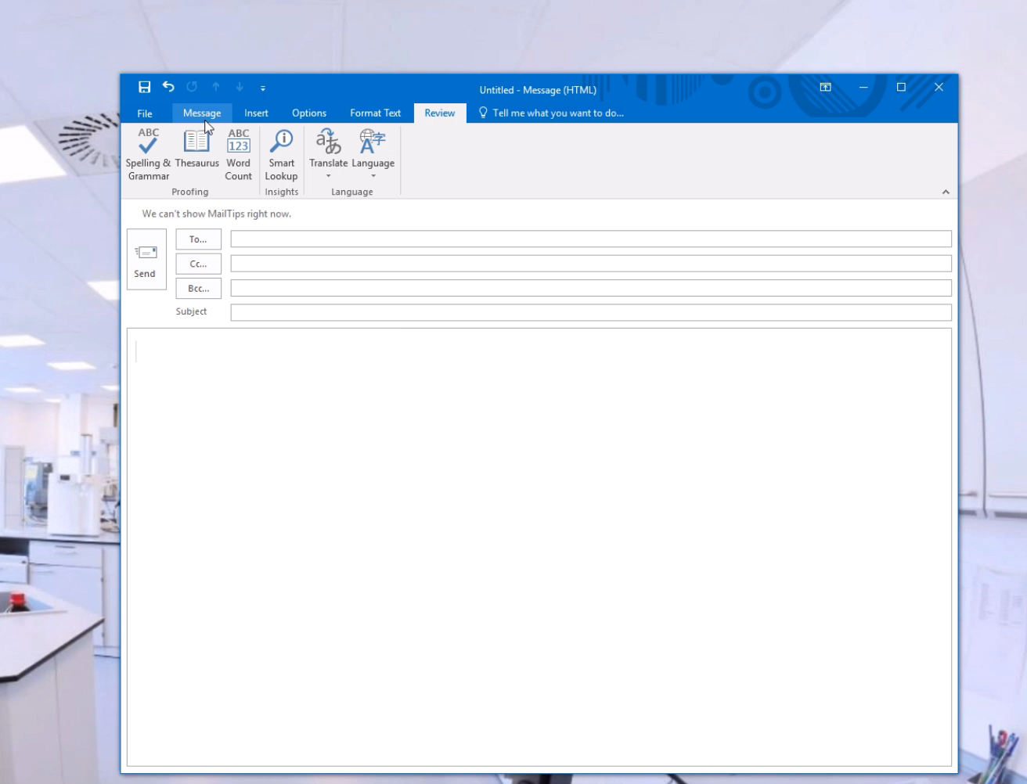

Slide 5
Dentist
I started my studies with biochemistry in 2002, next year I started my dentistry studies. After graduating, I realized that I wanted to expand my medical knowledge and got a licentiate of general medicine as well. With my skills and knowledge combined from both degrees guided me towards specializing in plastic surgery. I am still working as a doctor and a dentist in evenings and weekends to keep up and update my knowledge and my fine motor skills.
My work is mainly working in the hospital. Usually 1-2 days are policlinic days, meeting with current and future patients. Defining patients’ problem, planning the operations and post-operative check-ups. Defining the problem and especially discussing with the patients can be heavy as the responsibilities are huge. Explaining the possibilities and risks so that the patient fully understand is my responsibility. Conversely, after successful treatment and operations you can join the happiness with the recovering patient. 3-4 days of the week are days of surgeries. These days are the most motivating part of my job as I can make concrete changes for the human health and well-being.
I need to get along with many different kind of people in their worst moments. This requires a lot of human relations skills and cultural awareness. In my work, eye-hand coordination with good fine motor skills are required daily. During policlinic and surgery, I need to apply the wide-ranged knowledge about human systems and solve clinical problems. School chemistry, physics and biology studies are the foundation for acquiring new knowledge in my work.

Slide 6
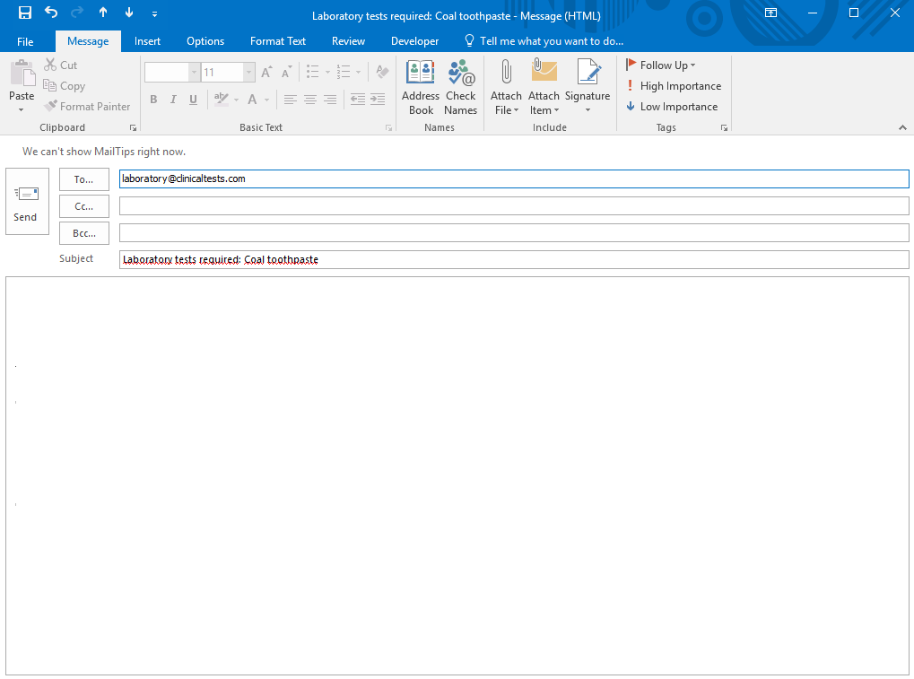
Dear chemists,
My patient asked me about a new product for teeth whitening: Coal toothpaste. Have you heard of this product? I will send the toothpaste to your laboratory
Can you please make the proper tests and answer the following questions:
  Is it safe to use in daily teeth care and teeth whitening?
  How effective it is in whitening the teeth?
  Is there enough fluoride?
  How abrasive it is?
  Would you recommend this product in teeth whitening?
I would also be happy if you could make a comparison of the current toothpastes because the information we have is 2 years old and therefore outdated.
I’ll look for your prompt reply and answers.
Best
Maija Savolainen (DMD, MD)

Slide 7
Re: test results
Hello!
Thanks for your test results. They really helped me a lot with this issue. Now that I have the recent knowledge I can use it in my daily work to inform my patients with up-to-date information.
The results were pretty much what I expected. We will continue to use our clinical teeth whitening method with hydrogen peroxide. I will forward this information to our patients..
Thanks a lot and have a nice day!
Best
Maija
Notes:
This slide is to be used after the inquiries.

