Slide 1

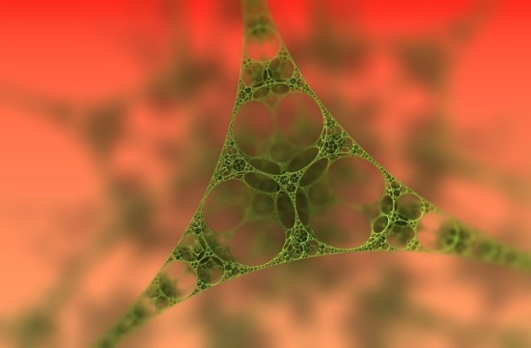
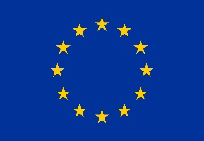

Is the next ‘big idea’ really small?
This project has received funding from the European Union’s Horizon 2020 research and innovation programme under grant agreement No 665100.

Slide 2
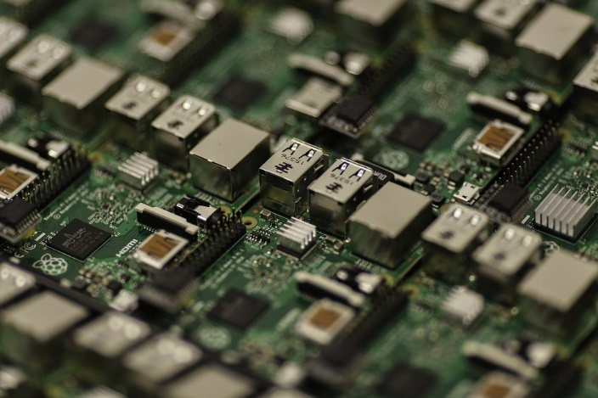

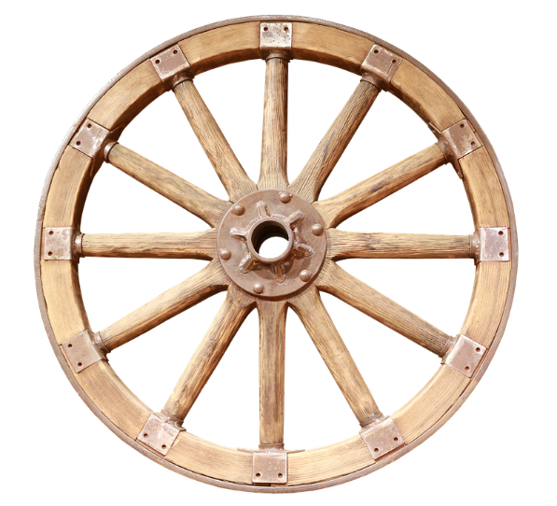
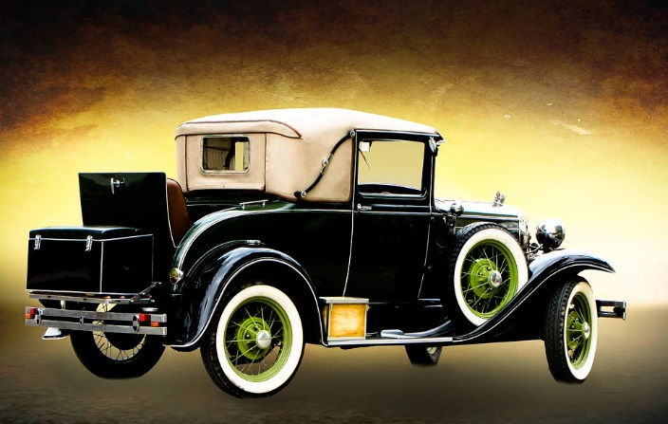

How did each of these ‘big ideas’ change the world?
Notes:
Discussion in groups

Slide 3
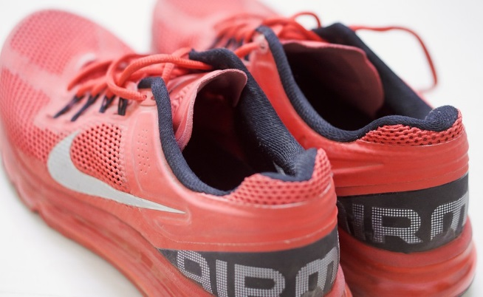

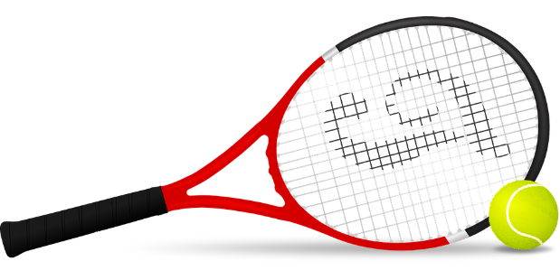
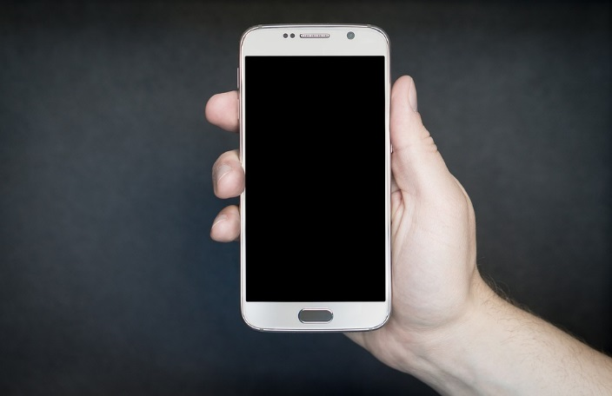
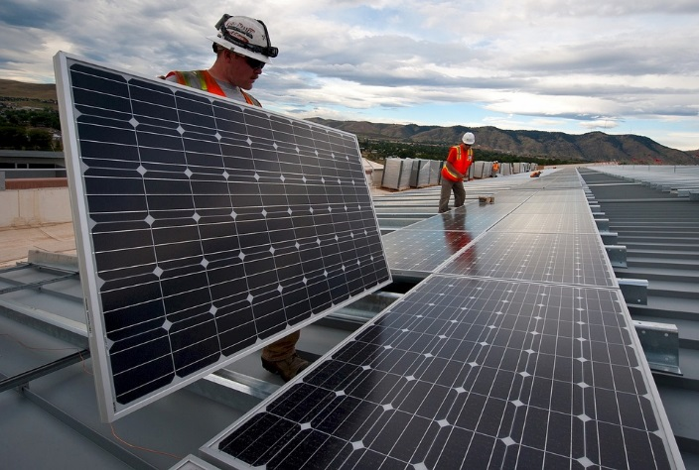
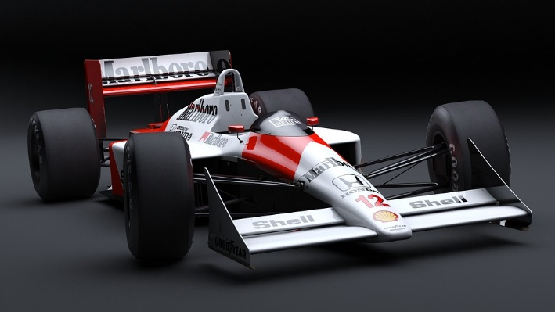
What links these images?
Notes:
Graphene

Slide 4
Is graphene this small ‘big idea’?
http://www.graphene.manchester.ac.uk/discover/the-people/sir-andre-geim/
http://www.graphene.manchester.ac.uk/discover/video-gallery/story-of-graphene/made-in-manchester/
Notes:
Watch first video 3.30 to end. Andre Geim talking about next industrial revolution
Read handout:

Slide 5
So what is graphene?
http://www.graphene.manchester.ac.uk/explore/the-story-of-graphene/

Slide 6
Sticking with graphene…
Read the Science Watch article
http://archive.sciencewatch.com/inter/aut/2008/08-aug/08augSWGeim/
Explain how Andre discovered the Scotch Tape method for producing graphene.
Try to make some yourself!
https://www.youtube.com/watch?v=PifL8bAybyc
or
https://www.youtube.com/watch?v=LwmxSjydPEE
Notes:
PDF of science article available

Slide 7
Graphene scientists awarded prizes
Andre Geim won a Nobel prize for science for his graphene discoveries. Many young scientists are also winning prizes for their work in nanotechnology:
Water purification: Sebastian Leaper
http://www.manchester.ac.uk/discover/news/manchester-scientist-develops-designer-membranes
Low power memory devices: Nazek EL Atab
https://www.youtube.com/watch?v=x6uzZRJprZw

Slide 8
Graphene: careers for the future
The European Graphene Flagship
http://www.azonano.com/article.aspx?ArticleID=4079

Slide 9
Careers for the future: Nanotechnology engineers
Eleanor Stride: Biomedical engineer
http://www.plotr.co.uk/careers/nanotechnology-engineer/
Or
Nano medicine scientist

Slide 10
Task
Research one of these prominent nanotechnology scientists.
Make a presentation to explain what he/she discovered, the possible uses of the discovery and suggest how this might revolutionise products, processes or medical treatments in the future.
Robert Langer
Gerd Binnig and Christoph Gerber
Mildred Dresselhaus
Sumio Iijima
Sean O’Brien, Richard Smalley, Robert Curl, Harry Kroto and James Heath.
Notes:
Also see landmark lesson plan
https://www.acs.org/content/dam/acsorg/education/whatischemistry/landmarks/lesson-plans/discovery-of-fullerenes.pdf

