Slide 1
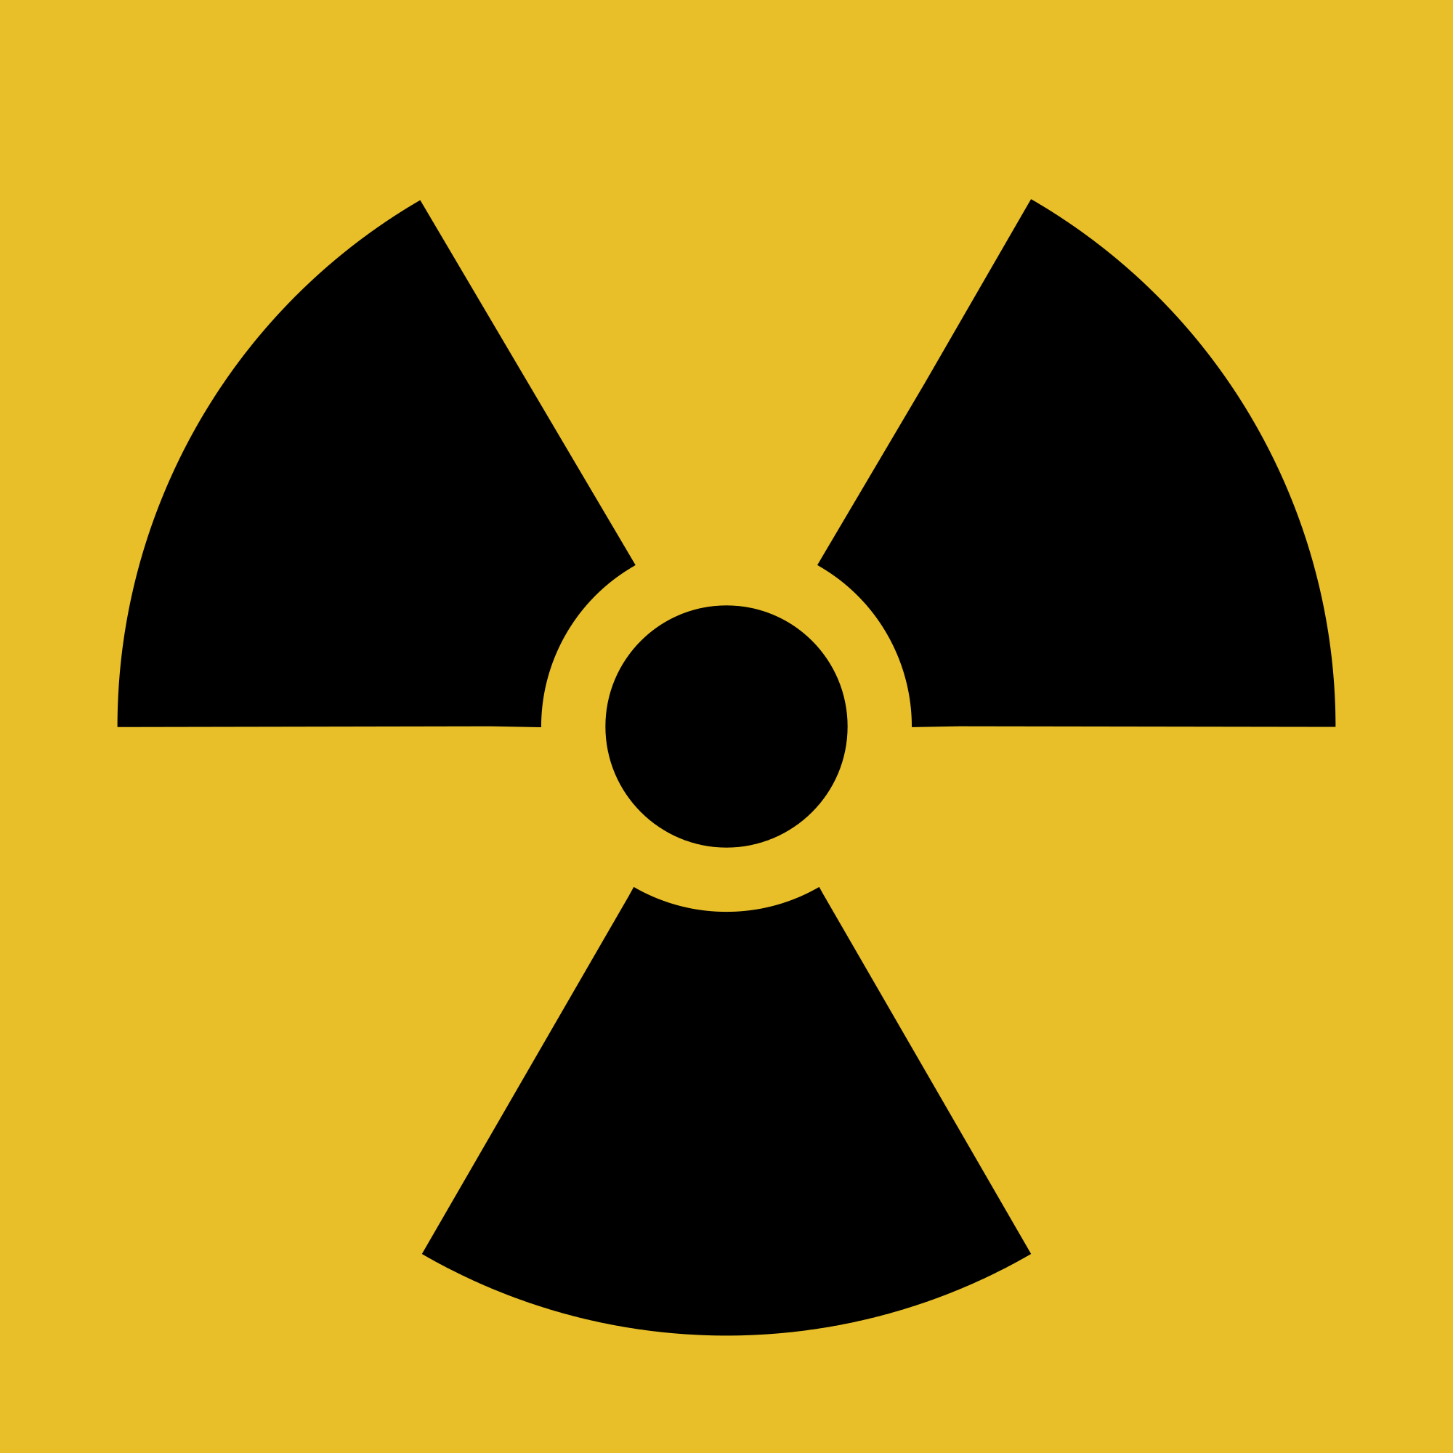
KQ-“Is there like a nuclear bomb in my body?!”
This project has received funding from the European Union’s Horizon 2020 research and innovation programme under grant agreement No 665100.

Slide 2
KQ-“Is there like a nuclear bomb in my body?!”
Starter- Jot down everything you think you know about radiation
TIF- ‘Radiation is always harmful’ Evaluate this statement
This project has received funding from the European Union’s Horizon 2020 research and innovation programme under grant agreement No 665100.

Slide 3
What is Nuclear Medicine?
Nuclear Medicine is a diagnostic medical imaging and treatment speciality. It combines elements of anatomy and physiology, chemistry, physics, mathematics and computing with patient care skills.
Radioactive tracers are administered to patients in order to diagnose and /or treat disease. Nuclear Medicine differs from other imaging techniques such as X-ray by giving information about the function of parts of the body, as well as their structure. The use of these radioactive tracers is closely monitored. The techniques are very safe both for the patient and for the technologist.
What type of person is suited to a career as a Nuclear Medicine Technologist?
A wide variety of people would be suited to a career as a Nuclear Medicine Technologist. The most important factor is an ability to work and communicate well with people.
While knowledge of science obviously plays an essential part, practical skills including patient care and interpersonal skills are equally important.
So… what is nuclear medicine?
I have underlined some tricky phrases… What do you think these mean?
Notes:
'computerized axial tomography' (CAT) scan

Slide 4
Nuclear Medicine Technologist
How do you train to become a nuclear medicine technologist?
There are two main routes to qualification as a Nuclear Medicine Technologist.
You can choose a four year part-time BSc in Clinical Technology with specialisation in Nuclear Medicine during the degree. This is combined with training based upon formal practical experience in Nuclear Medicine.
The other route is to take a BSc in Radiography, which takes three years, and then specialise in Nuclear Medicine, after first qualifying as a Radiographer. Practical experience can be obtained by working in a nuclear medicine department in hospital.

Slide 5
So what does the job involve?
Nuclear medicine technologists typically do the following:
Explain imaging procedures to the patient and answer questions
Follow safety procedures to protect themselves and the patient from unnecessary radiation exposure
Examine machines to ensure that they are working properly
Prepare radioactive drugs (radiopharmaceuticals) and administer them to the patient
Monitor the patient to check for unusual reactions to the drugs
Operate equipment that creates images of areas in the body, such as images of organs
Keep detailed records of procedures
Follow radiation disposal and safety procedures
Remember there are dangers to radiation source !!!!!
Think pair share: What skills might a NMT need?

Slide 6
Dealing with patient fears
One of the skills required is being able to deal with patient concerns in a sensitive manner.
Watch the start of the following video and then discuss how Deepa handles the patient’s concerns.
https://www.youtube.com/watch?v=-vDmlAN1B-g
Can you give Deepa a few tips to help her calm the patient down?
Notes:
Teachers click on link.
Watch up to 1:58 mins.
Possible role play?

Slide 7
Devise a role play for a Nuclear Medicine Technologist and her patient
What is your PAFT?
Rules
Work in pairs
Each take a role
Write a script
Ensure you clearly discuss the science, the benefits and risks, include language that is appropriate to your part
ANY QUESTIONS

Slide 8
Radiopharmaceuticals STARTER- Read the information below and then rewrite it as best you can so a year 7 could understand it
KQ-“Is there like a nuclear bomb
in my body?! 2”
Radioactive drugs, known as radiopharmaceuticals, give off radiation, allowing special scanners to monitor tissue and organ functions. Abnormal areas show higher-than-expected or lower-than-expected concentrations of radioactivity. Physicians and surgeons then interpret the images to help diagnose the patient’s condition. For example, tumours can be seen in organs during a scan because of their concentration of the radioactive drugs.
TIF- Are radioactive drugs safe? WHAT DO YOU THINK?

Slide 9
Uses of radiopharmaceuticals
Radiopharmaceuticals can be used either for diagnostic or therapeutic (treatment) purposes. It is made up of a radioactive substance bonded to another molecule. This molecule carries the radioactive substance to specific organs, tissues or cells. The radioactive substance is selected according to the type of radioactive particle emitted.
Use your common sense to suggest what characteristics the radioactive substance should have ….
Would their characteristics need to be different if they were either
diagnostic (working out what’s wrong with you)
OR
therapeutic procedures (treating what’s wrong with you)
diagnostic – short term, get in the body easily and out body easily
therapeutic – mid-term, stay in the body slightly longer

Slide 10
Diagnostic radiopharmaceuticals
Radioactive substances emitting penetrating rays (called gamma rays) are used for diagnostic (imaging) where the radiation has to escape the body before being detected by a specific device (special cameras). Typically, the radiation emitted by the Radioactive substances used for imaging vanishes completely after 1 day through radioactive decay and normal body excretion.
why is this important?

Slide 11
Therapeutic radiopharmaceuticals
Radioactive substances emitting short range particles (called alpha or beta particles) are used for therapy due to them losing their power over a very short distance, therefore causing a lot of local damage (such as cell destruction).
This characteristic is used for therapeutic purposes: cancer cells destruction, pain treatment in palliative care for bone cancer or arthritis. Such Radioactive substances stay longer in the body than imaging ones; this is intentional in order to increase treatment efficiency, but this remains limited to several days.

Slide 12
So back to Deepa..
Nuclear Medicine Technologists need to be able to prepare and administer the radioactive tracers.
But ….

Slide 13
Which Radioactive substance would Deepa use for diagnosis and which one for treatment of the thyroid?
Iodine 123 or Iodine 131?
I-131 -half life of 8 days
I-123 - half life of 13 hours
But first…
What does half life mean??
Notes:
Could plot on the same graph to decide which is best for diagnosis etc. If more data tasks are needed there could be a focus on the proportion of any radioisotope left inside a patient’s body after a certain amount of time e.g. after 24 days, a quarter of I-131 will remain. There can also be a focus on the type of radiation too. Example of decay curve for I-131 is given on the next slide followed by a list of typical radiopharmaceuticals.

Slide 14
Typical radiopharmaceuticals - Fill in the table
Diagnostic
Therapeutic
Notes:
Consolidate what would be key properties for each group in terms of half life, energy and penetration power.

