Slide 1
Oil- the king of the world or achilles heel?
This project has received funding from the European Union’s Horizon 2020 research and innovation programme under grant agreement No 665100.

Slide 2
Oil- the king of the world or achilles heel?
https://zambiareports.com/wp-content/uploads/2017/03/Oil-Production.png
This project has received funding from the European Union’s Horizon 2020 research and innovation programme under grant agreement No 665100.

Slide 3
OIL
https://springsadvertiser.co.za/151307/another-massive-price-hike-for-petrol-and-diesel-at-month-end/
Is a leader in the energy sector: 40% of our energy is produced from oil, including cars, tractor and airplane fuel, household gas, fuel oils, kerosene and coating material bitumen
Although in practice we don’t pay much attention to this, it is needed to know that on this mineral resource depends largely all human activity: heat, light, transport and materials around us

Slide 4
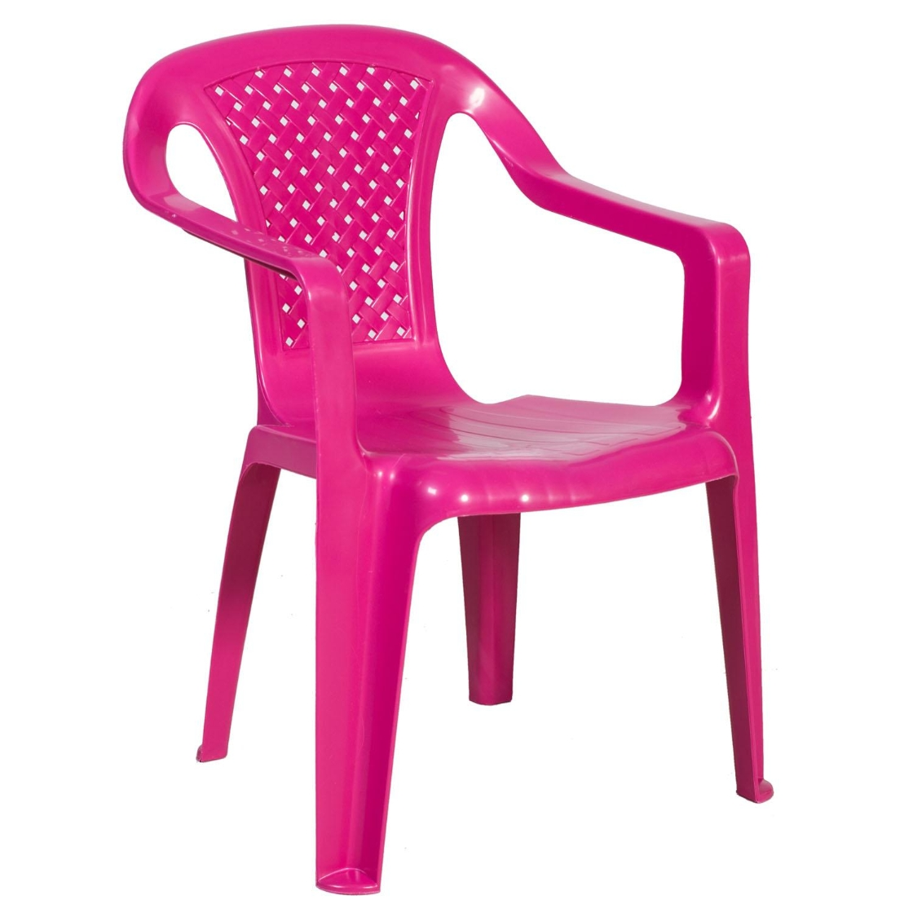
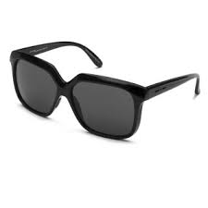
What if WE DON’T HAVE OIL
http://www.italiaindependent.com/gb_en/i-plastik-0914.html
https://tinyurl.com/yconxywr
https://tinyurl.com/y7yav6vy
the shower curtain and the mixer would just disappear as if it hadn’t been
All cosmetics and cosmetics toiletries are like swept away
Since shampoo and soap are gone, then there would be a really big problem with your personal hygiene
The same fate will hit computer, printer, phone- none of these wouldn’t exist it there weren’t plastics (produced from oil)
All electrical and telephone cables would be bare (J. Marshall)

Slide 5
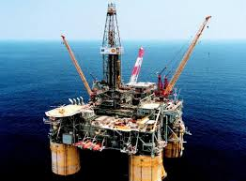
PRODUCTION of OIL from boreholes
What professions are needed in oil production?
https://tinyurl.com/yaus2sto
https://tinyurl.com/y9tzs4jc

Slide 6
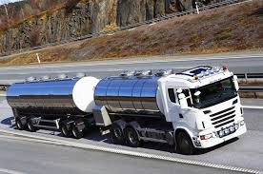
Transportation of oiL
http://photos.marinetraffic.com/ais/showphoto.aspx?mmsi=276260000&size=
https://encrypted-tbn0.gstatic.com/images?q=tbn:ANd9GcR92tCqN3EPdGDNh1fNcgFKqo3qHYt26qWJ5ZOcC9mV0kCFh8bQIQ

Slide 7
Burning Iranian Tanker Sinks Off China's Coast
An Iranian oil tanker that had been burning and listing off the coast of China, exploded into a mass of flames and sank
The Panama-registered tanker Sanchi was sailing from Iran to South Korea carrying 136,000 metric tons of condensate, an ultra-light type of crude oil, when it slammed into the Hong Kong-registered CF Crystal about 257 kilometers off the coast of Shanghai
The ship was carrying grain from the United States to China
It is not clear what caused the collision (Postimees, Maailm, 14. January 2018)
https://www.voanews.com/a/burning-iranian-tanker-sinks-off-china-coast/4207040.html

Slide 8
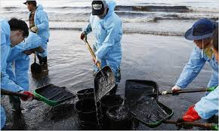
What professions are needed in oil cleaning cases?
https://tinyurl.com/y9xzvw3q
https://preview.tinyurl.com/ybbw5dsj

Slide 9
RELATED CAREERS
We think that the following professions are needed for oil production, transportation and oil spill clean-up:
Oil production from boreholes | Oil transportation through pipelines and tankers | Oil spill cleaning from the sea and land

