Slide 1



Why was the pedestrian crossing in front of the school removed?
This project has received funding from the European Union’s Horizon 2020 research and innovation programme under grant agreement No 665100.

Slide 2


The following piece was published in the letters for the editor of the local newspaper a few months back.
In Kontiolahti city centre, from the junction between Keskuskatu and Puutarhatie the pedestrian crossing on Keskuskatu was removed a few years ago. Many people wonder why?
There is a subway right next to the junction. Is this the reason why the pedestrian crossing was removed?
Having watched the situation, I have noticed that neither the students not teachers use the subway. People seem to still use the ghost pedestrian crossing, which in my opinion would still be a logical choice for the crossing.
Could somebody please examine the situation and draw up a letter for the policy-makers to guarantee the safety in this junction?

Slide 3
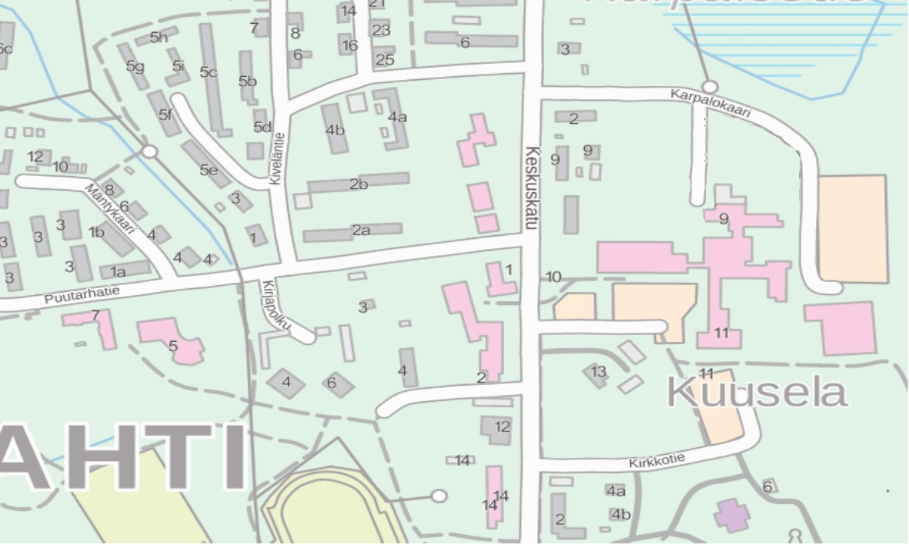
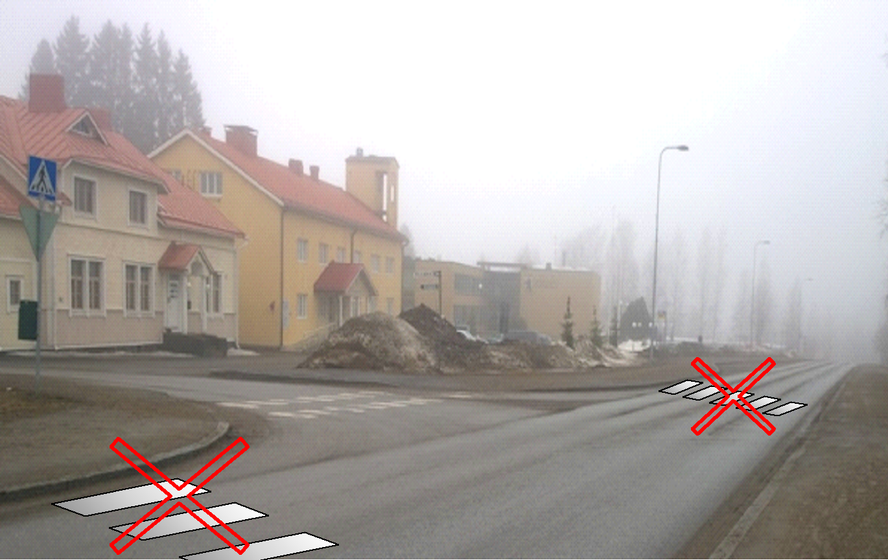
Who in the
municipality is responsible?
Houses and apartments
SCHOOL
School
LIBRARY
SUBWAY

Slide 4
Municipal engineer
Is responsible of
  Provision and operation of various services vital for the community such as maintance of streets and parks
  Infrastructure investments
Work includes
  Collaboration with early-planning, zoning, supervision and other units.
  Overall management
  Planning far-reaching strategies
Requirements for the work
  Studies of Master of Science in Technology
  Planning, development and leading skills, teamwork skills, problem solving skills
  Good language skills
Our mission is to build, develop and maintain cozy and appropriate municipal structure. In the unit of streets and parks we collaborate with different units, professionals and the community.

Slide 5
We should draw up a letter for the chief municipal engineer.
We should present facts to support the necessity of the pedestrian crossing.
Do we as citizens have the possibility to influence municipal decision-making?
Let’s try!

Slide 6
What are the facts we should present?
The speed limit at Keskuskatu is 30km/h. Do people obey it in reality?
Do the pedestrian crossing signs influence the velocity?
How much do people use the subway or is crossing the road without any pedestrian crossing more used?
Why should there be a pedestrian crossing in this particular point, although there are others nearby?
How do mobile phones threaten the road safety?

