Slide 1
“City congestion leads to traffic light rethink” Introductory scenario for introducing road junction design
This project has received funding from the European Union’s Horizon 2020 research and innovation programme under grant agreement No 665100.

Slide 2
“City congestion leads to traffic light rethink”
With young people only having limited options of travelling by road in Castlebay many are fed up with delays when trying to go out to meet friends and some at being made late for school due to congestion. Most young people get a lift into the town centre on Saturdays and during the holidays or in the mornings on school days but find that the common occurrence of traffic jams to cause them to stress out.
Notes:
Slide 2 Guideline parameters 2 & 3: interest and relevance to students’ lives
Image By Roger Cornfoot, CC BY-SA 2.0, https://commons.wikimedia.org/w/index.php?curid=14173462

Slide 3
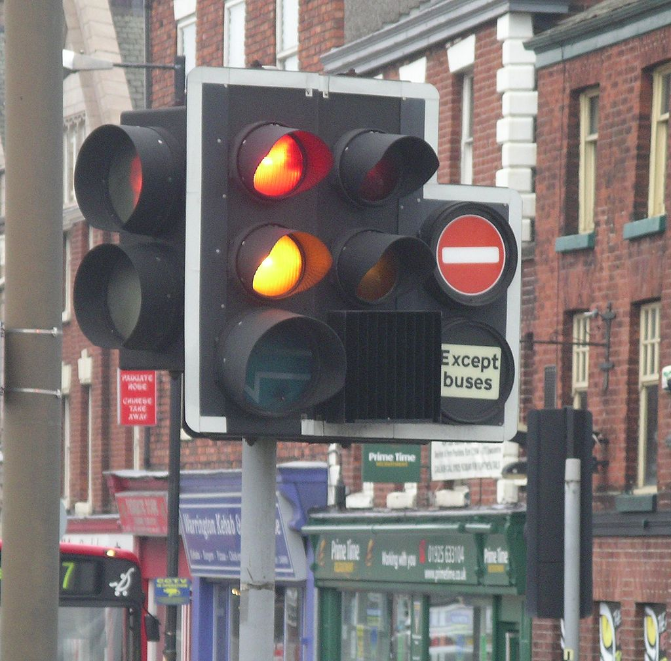
Some school students researched the causes for the congestion and found that when traffic lights were switched off there was a reduction in traffic delays. They decided to write a letter to the Castlebay council proposing changes to junctions with traffic lights.
Notes:
Slides 3, 4 & 5. Guideline parameters 1, 2 & 3 (starting from here we rely on the teacher`s state of the art as to how to present the scenario, what to emphasise, what becomes important!!)
The fragments taken from the newspaper can be developed further into the full story, including locally specific aspects. The story is intended to sets up a platform for discussion, whether on what the journalist wrote based on evidence or emotions, or the probability of related issues, etc. For example, the teacher could say – ‘We all know that journalists are writing all sort of stories. Based on the journalist`s article, do we think he had enough science background or not? Of course, all questions might come from students leaving the teacher to be the facilitator.
Traffic lights in Warrington Author: User:Velela

Slide 4
Council consult Transport for Castlebay (TfC)
Representatives meet with civil engineers from TfC who design traffic junctions to see if improvements could be made to junctions to reduce traffic congestion but maintain safety for all road users. Engineers regularly meet with civil representatives and must be aware of legal issues relating to the rules of the road.

Slide 5
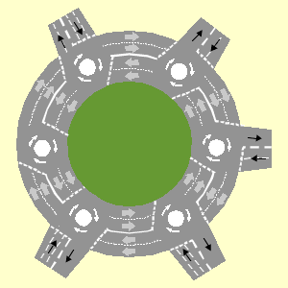
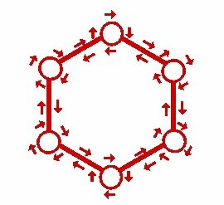
TfC engineer’s design
A group of engineers from TfC were tasked with designing alternatives to traffic light junctions to reduce traffic delays, particularly for junctions with more than four roads meeting at a junction to provide uninterrupted traffic flow. Engineers have to produce models that non specialists can interpret.

Slide 6
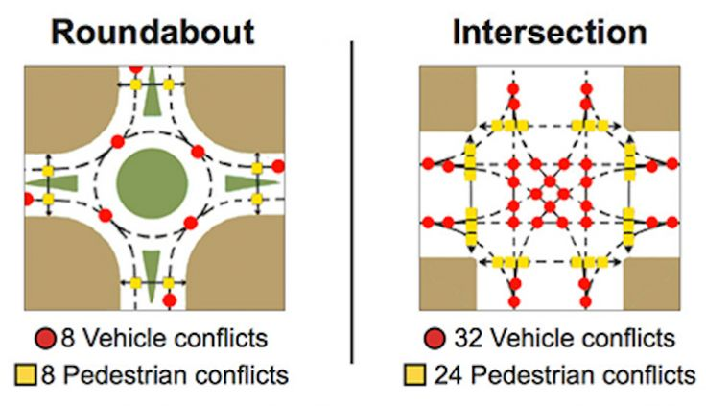
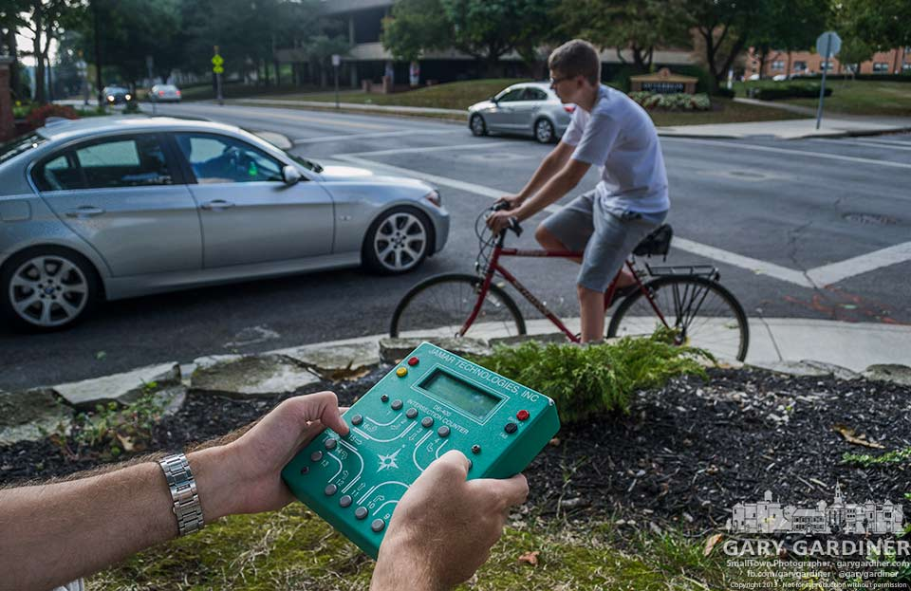
Magic roundabout design
Engineers investigated the potential use of magic roundabout junctions where multiple mini roundabouts are located around a central roundabout by conducting traffic flow studies at existing traffic light junctions and roundabouts. Engineers must be able to collect data regarding traffic flowand make conclusions that will be published in reports so that all interest groups can have a say before any work starts.
Notes:
Slide 6. Guideline parameters 1 & 3 partly depends on student`s home background (again this slide strongly benefits from the teacher´s input!!)
This slide introduces how people can change their career direction and how a scientific background well supports other career options. This slide also indicates that Martin`s father wanted to visit the factory himself to understand the process more fully and the fact that his interest in science and technology was still there, even thought he had changed his job.

Slide 7
Technical design
Notes:
Slides 7 to 11. These take us step by step into orangeade production (Guideline parameter 1 definitely)
The slides are far from being excellent as they are portrayed (CC licence must be considered, a photos must reflect correctly the activity, science and technology updates are essential) - but we hope such slides are good enough to introduce the intended idea behind!
Slide 7 shows the importance of the R&D team, also as the top of the career track – where, besides science skills, social and personal skills become important. This is about science-in-society and for society interactions (Guideline parameters 1 & 3) One photo, currently missing, could show beer production in the same factory, so as to build the link between using the excess CO₂ formed during beer production to give ‘the fizz’ for orangeade--- this will give an extra dimension for the R&D team.

Slide 8
Magic roundabout design
Notes:
Slide 8 chemistry/ biochemistry laboratory, working on new ‘sorts’ of orangeade products, or improving the quality of the existing production. This laboratory works in collaboration with the R&D department, emphasising the need for practical skills linking with orangeade production. In this, different specialisations appear in the slides. (Guideline parameters 1, 4 & 2,3 probably not for all). This slide provides a direct link to science content learning / teaching e.g. solubility of gases, acid- base reactions, titration, etc.

Slide 9
Consulting local people
TfC then had to consult with local residents about their designs for the new junctions and explain about the disruption that may occur in building the new magic roundabout as well as issues concerning pedestrian safety. Engineers have to make presentations to interest groups and answer any queries or concerns that the public may have.
Notes:
Slide 9 - technological aspects, technological planning. This slide is important to predict at which stage the wasp might have climbed into the bottle and what should be undertaken differently in quality control in order to discover the wasp (Guideline parameters 1 & 3).

Slide 10
Contextualised learning
This could lead into students doing surveys of road use and then making measurements of vehicle speeds that would lead onto graphical representations.
They could also learn about road surfaces and factors that affect stopping distances and other road safety issues.
Notes:
Slide 10 Quality control laboratory. This is mainly a technical unit. People here are following instructions. The unit works in tight contact with the technology – production unit. (Guideline parameters 1&4), and provides a direct link to experimentation skills, inquiry activities; and content wise to - solubility, pH, density

