Slide 1
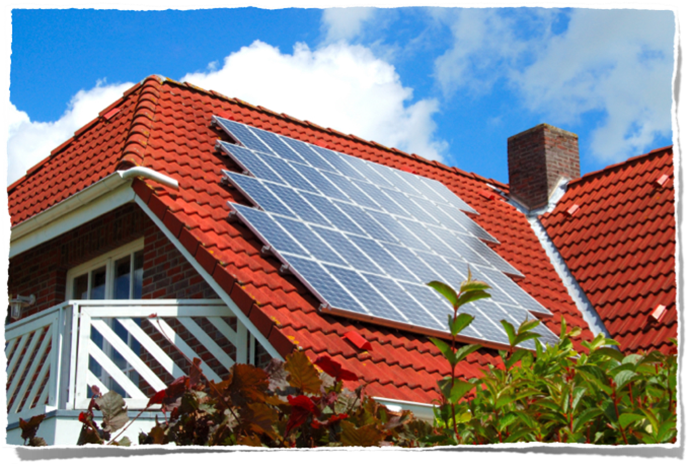
“ELECTRICITY IN THE AIR”
This project has received funding from the European Union’s Horizon 2020 research and innovation programme under grant agreement No 665100.
This project has received funding from the European Union’s Horizon 2020 research and innovation programme under grant agreement No 665100.

Slide 2
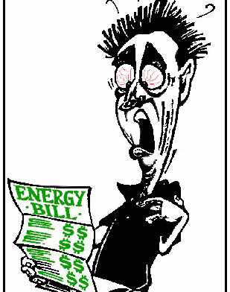
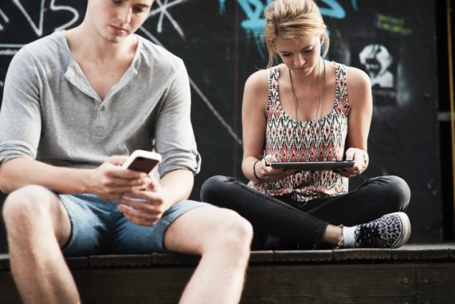
Argument about monthly electricity bill
Meet David. He is a dad of two teenage kids: Mary and Jack.
Year by year their familys’ electricity bill has increased
David blames the kids, who use their phones and tablets constantly for playing and chatting
http://www.dailymail.co.uk/sciencetech/article-2333261/We-spend-MORE-time-phones-partner.html
http://obrag.org/wp-content/uploads/2009/12/energybill.jpg

Slide 3
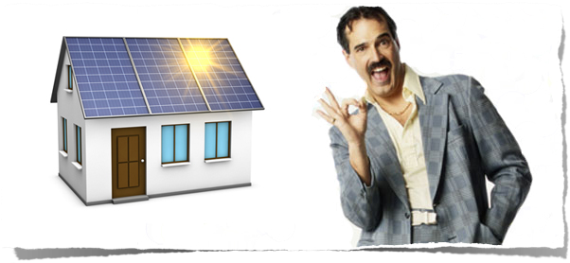
David has decided to try out solar power, because…
“It reduces electricity bill
Efficient even in northern countries like Estonia and Finland
Quote calculation for free” according to the solar panel installation company.
http://sanjosegreenhome.com/wp-content/uploads/2014/07/used-solar-panel-salesman.jpg

Slide 4
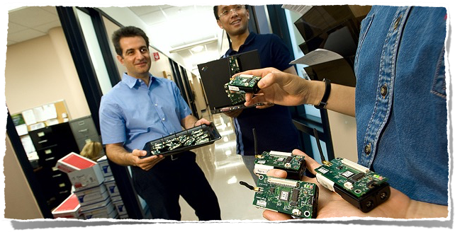
David decides to ask friends’ advice
Meet Marcus, an electric engineer, and a friend of Davids’
David invited Marcus to visit him at home so he could consult about solar panels installation
http://www.bu.edu/ece/files/2009/04/paschalidis_with_students.jpg

Slide 5
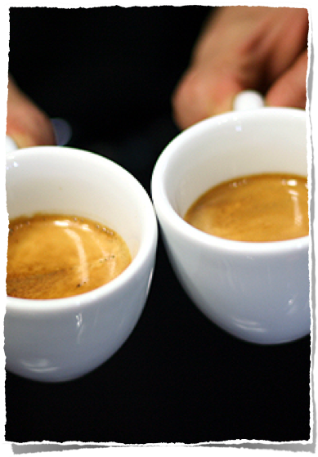
David catches up with Marcuses life and work by a cup of coffee and asks, what are his job responsibilities as an electrical engineer
“Well, electroenergetics is dealing with the questions like:
why sometimes we have electricity and sometimes we don’t;
why the electrical current is unsteady;
how does electricity reach to your sockets; and how to produce electricity”
http://www.davidlebovitz.com/2008/07/where-to-find-a-good-cup-of-coff/

Slide 6
As David hasn´t seen Marcus for years, they discuss, what Marcus has been doing so far.

Slide 7
Mary, Davids' daughter, wants to know more about becoming an electrical engineering
Mary got inspired. “We use electricity every day and without it, we feel like back in stone-age. It is difficult to cope without it. How would I charge my smartphone,” she thought.
“What skills are necessary to become an electrical engineer?” she took the courage to ask Marcus.
http://blush.com.pk/things-pakistani-women-crave-to-hear/woman-listening-by-michal-marcol1/

Slide 8
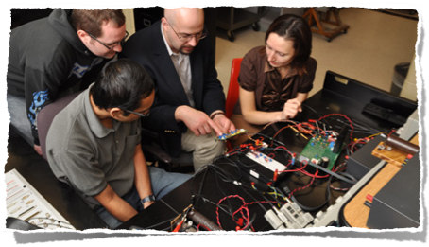
Skills necessary to become an electrical engineer
One needs to be able to work independently, be precise, work in teams and be good in organising;
One needs to be good at using computers;
needs to be able to analyse data and make decisions accordingly.
http://www.mtu.edu/ece/graduate/electrical/

Slide 9
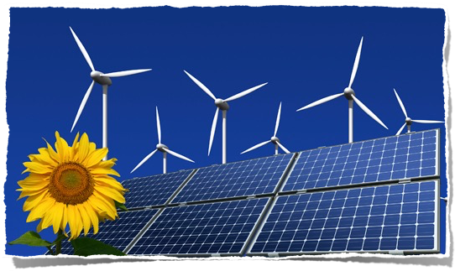
HOT Topics in energetics
Constant need to improve technologies of using fossil fuels to make energy production more efficient
Develop and improve technologies for renewable energy sources
http://www.eecs.umich.edu/eecs/about/articles/2011/Hiskens-Energy.html

Slide 10
What other careers are involved in developing solar panels and in energy industry?
Materials Scientist
Material Science is quickly developing field, and its´ aim is to discover and develop new materials like:
the ones that prevent airplanes from rusting;
materials for absorbing suns´ rays in solar panels
Materials Science is used in electronics, energetics, medicine, IT, construction etc.
What is needed to become Materials Scientist?
Good analytical skills
Good communication skills to work in teams, present research results in written and in oral form
Critical thinking and problem solving skills
Good Math and computer skills
http://ametid.rajaleidja.ee/Materjaliteadlane-1

Slide 11
What other careers are involved in developing solar panels and in energy industry?
Environmental Protection Specialist (EPS)
EPS-s are like environmental police officers. Their job is to:
make sure that different industrial and human activities wouldn´t harm the environment and therefore human health and properties
Their work is very versatile:
Work with computers and work on the field- doing environmental surveys; visiting companies; deal with problems connected with fishing regulations; waste management etc.
What is needed to become Environmental Protection Specialist?
Good communication skills
Ability to make decisions and take responsibility
Good stress tolerance
Good analytical skills
Initiative
Good physical shape for field work and love for nature
http://ametid.rajaleidja.ee/Materjaliteadlane-1

Slide 12
Davids thoughts “lighted up” as installing solar panels onto his roof of the house, was the main cause of Marcuses visit.
https://www.flickr.com/photos/cayusa/981372736
“It is possible and beneficial to install them, but you need to consider the following aspects:”…

Slide 13
Technical aspects to consider:
Location (in Estonia facing South)
Roof construction
Installation framework
Whether you would like to use it just for your own household or sell it to electrical company and become a micro-producer
https://unmgrc.unm.edu/conference/2013-conference/images/compass.png

Slide 14
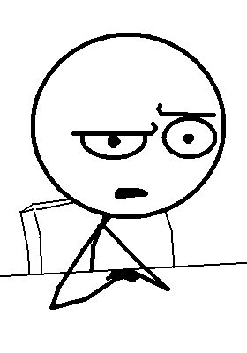
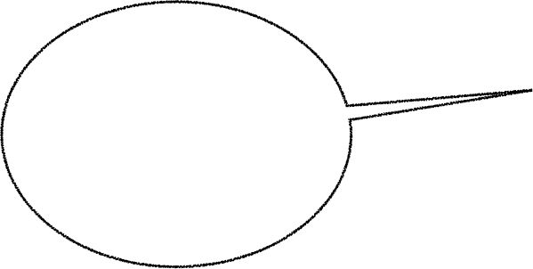
This technical talk got David confused
“Isn’t there a way to make solar panel for my kids by ourselves, so they could charge their smart devices in a “green way?”
http://kerrr-ni.blogspot.com.ee/2014/04/saving-best-for-last_6.html

Slide 15
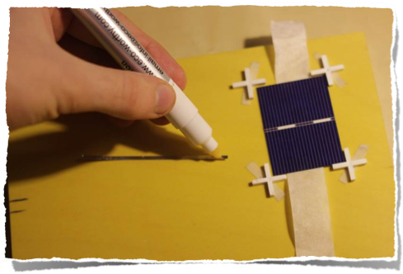
“Of course! It isn’t difficult at all! I’ll help you, and invite your kids
to join us! It will be fun”, said Marcus
Photo: Karl Tammiste

Slide 16
This teaching material is developed by Science Education Center, in
University of Tartu, Estonia and has received funding from the European Union's Horizon 2020 research and innovation programme under grant agreement No 665100.

