Slide 1
Houses, where we live
This project has received funding from the European Union’s Horizon 2020 research and innovation programme under grant agreement No 665100.

Slide 2
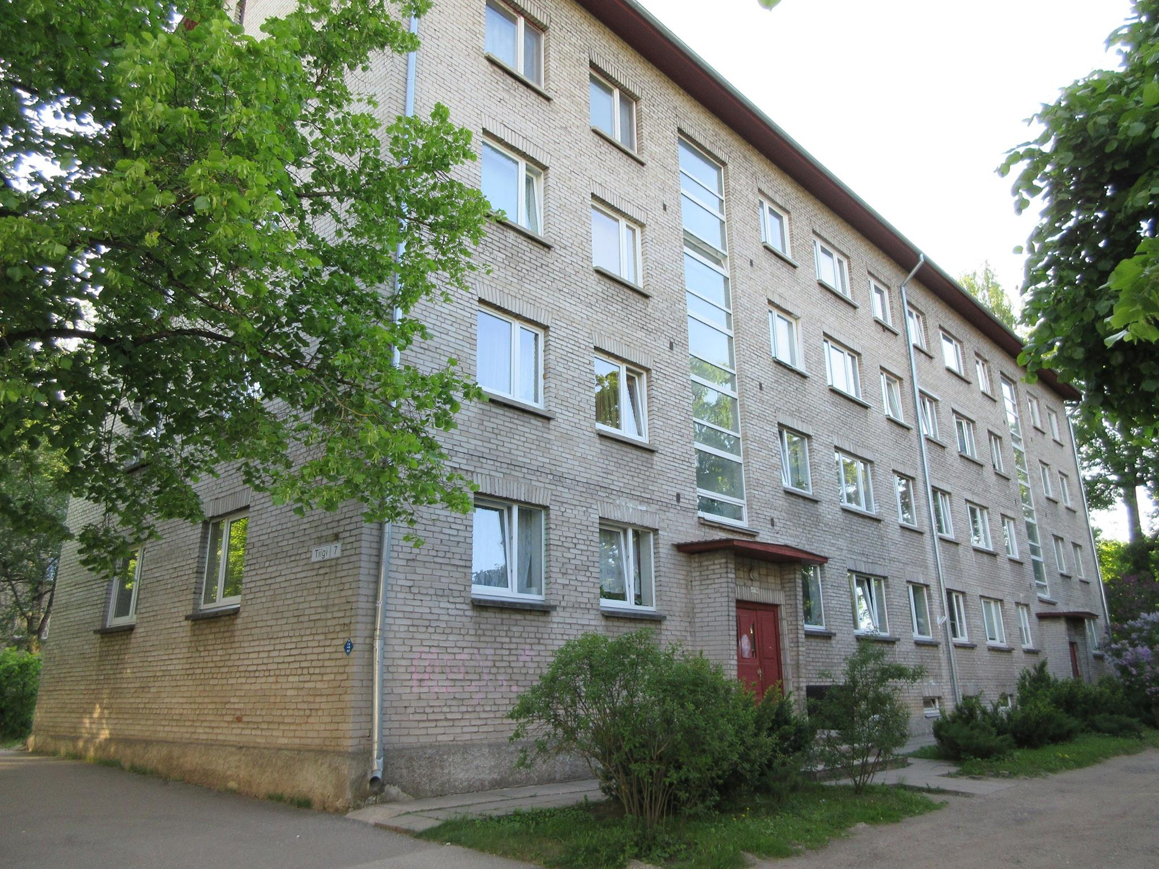

Slide 3
Human Geographers help make Tartu more smarter
University of Tartu, Department of Geography
The Mobility Laboratory participates in the European Union
Project SmartEnCity, helping the city center of Tartu
to be more energy efficient and smarter
http://www.geograafia.ut.ee/et/osakonnast/inimgeograafia-regionaalplaneerimise-oppetool

Slide 4
Khrushchyovka Smart homes
Solar panels and smart devices make khrushchyovkas
modern smart homes
Ragne Jõerand,
25. January2016
All buildings that will be renovated will also be equipped with a smart home (smart home management) solution that will make day to day living more convenient and help to monitor energy consumption. Electric vehicle charging points and electric bicycle and vehicle rental stations will be installed in the smart city district.

Slide 5
Reasons and goals
These houses are in terrible condition, consuming energy at 270kw/h per square meter per year and their systems have been depreciated.
In some of these old houses, windows have been exchanged for energy saving, but this is not enough.
Full renovation.
Due our project we want to achieve that energy consumption decreases by 2/3 and reaches to zero-energy houses.

Slide 6
Smart solutions
Smart homes get solar panels;
Smart home IT solutions;
Electric vehicles and bicycle rental points are nearby.
People don’t need to have a diesel or petrol cars again, if they know that an electric car can be reached 50 meters from home.

Slide 7
Artworks on the building facades
We believe that smartcity is also an artcity and smartcity also loves art.
To implement this idea, we organize an international street artist competition where we will certainly invite one of the most famous street artists in the world, Bansky from England. You know- maybe some houses are going to be unique under his own hand.
More citizens should be involved in the implementation and planning of these ideas.

Slide 8
Parking places
As the smart homes project directly affects the people currently living in these houses, it is also essential to listen their opinions about the project. There have been already two meetings with apartment associations and since there are many older people living there, it is a real challenge to make everything clear for them.
For example, when we said that everyone doesn’t need a personal car, because an electric vehicle can be rented advantageously, one man said really madly that: “Young man, talk about yourself”.

