Slide 1
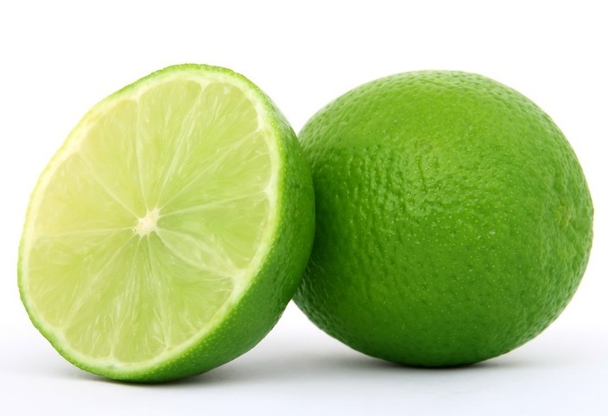
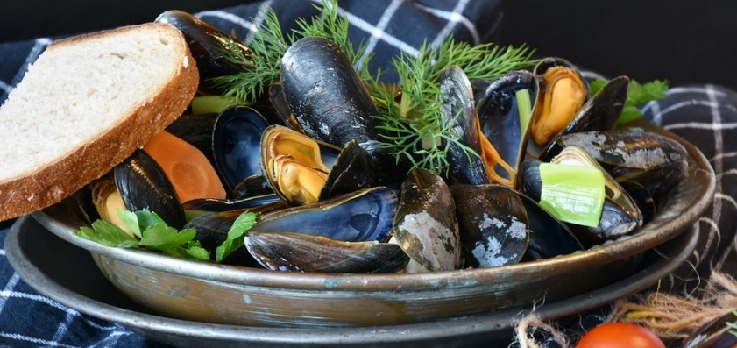
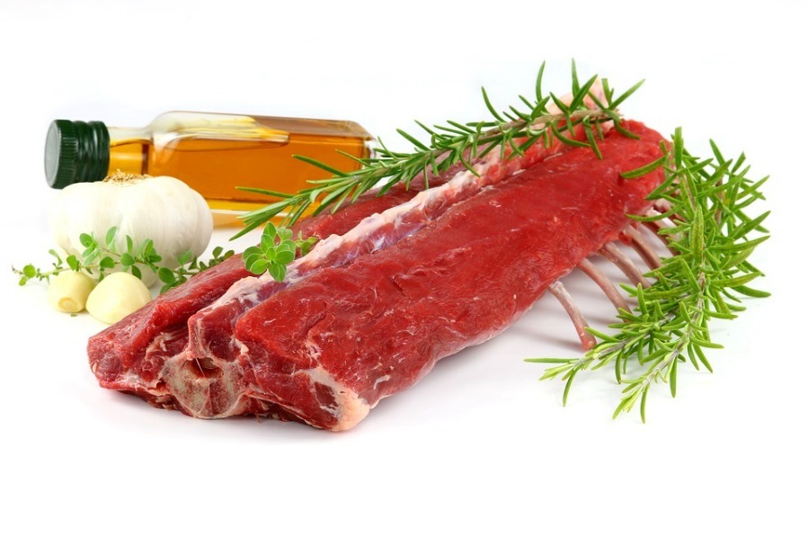
Lamb, lime and mussels: a recipe with a difference!
This project has received funding from the European Union’s Horizon 2020 research and innovation programme under grant agreement No 665100.

Slide 2
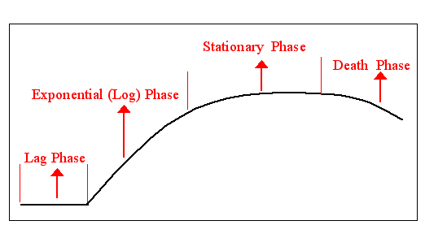
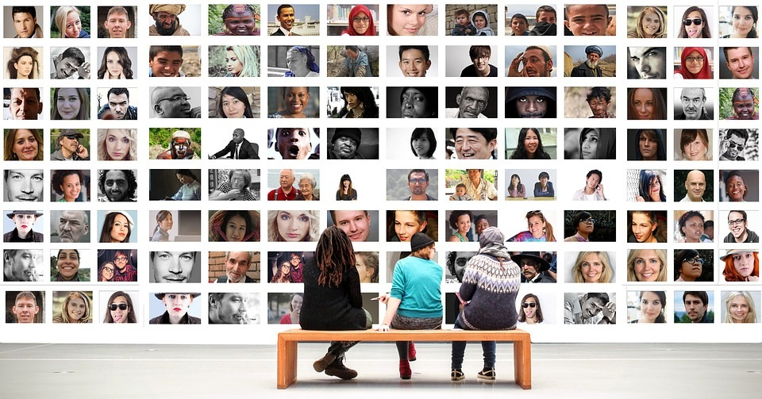
What next for the human population?
The human population to date: Our population recently reached 6 Billion. Growth is predicted to begin to decline about 2050 and reach an equilibrium at about 2100.
What could cause the death phase? How can the human population avoid this?
Bacterial growth curve
Notes:
Compare population growth in bacteria and humans. Eg similarities and differences. Reasons for differences? Draw out importance of increased food production and disposal of wastes if human population to continue to rise or stabilise

Slide 3
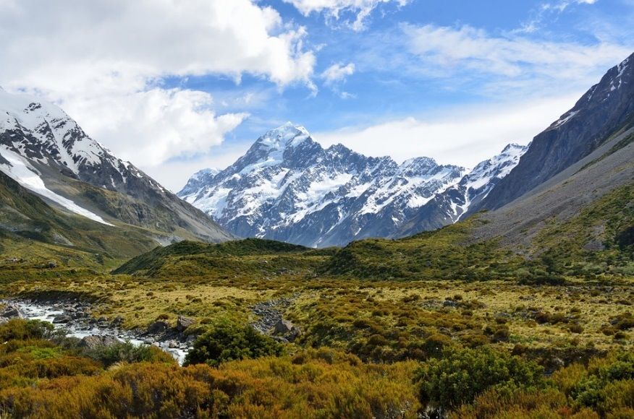
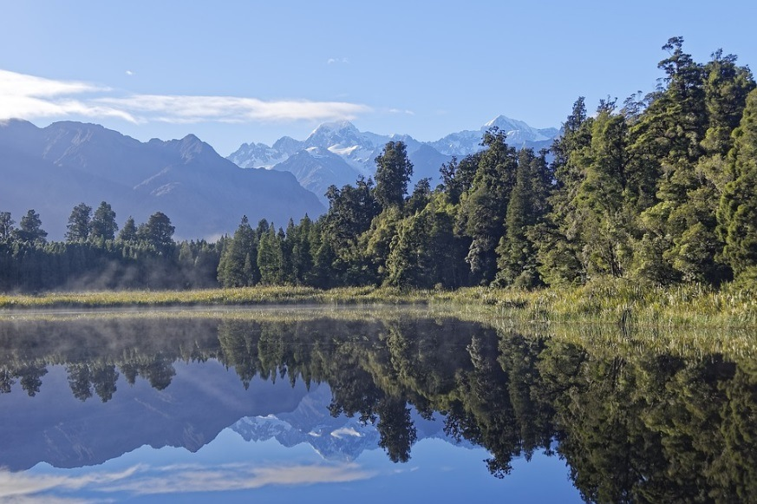
Introduction
In this scenario we will look at problems associated with both food production and waste disposal in New Zealand.
What foods are important exports for New Zealand?

Slide 4
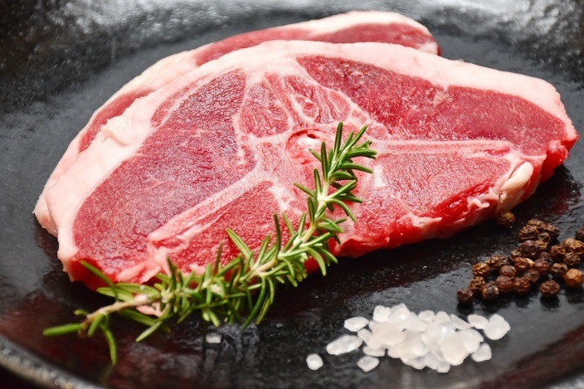
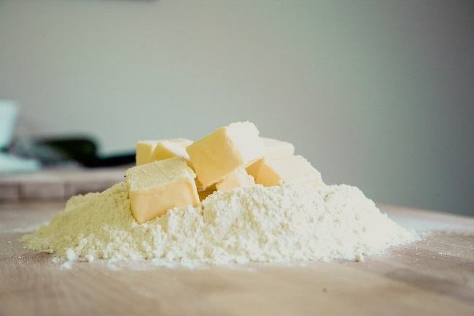
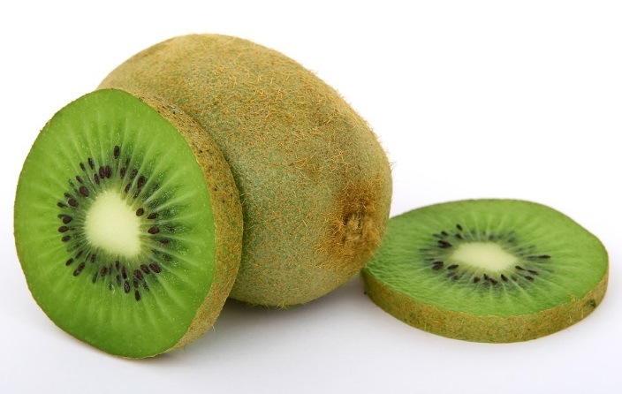
Answers

Slide 5
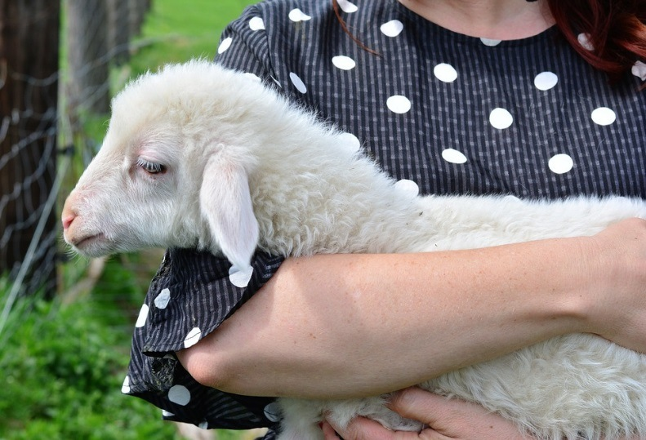
The character: The sheep farmer
She has a flock of 5000 Romney sheep. These sheep are a good breed for both meat and wool. In New Zealand sheep can be kept outside all year because of the climate and can feed on natural grass. This is unlike sheep in the UK which have to have grain added to their diet. New Zealand lamb is much cheaper than British lamb because of the size of the flock and the way the sheep are farmed.
Sue is a sheep farmer in the Marlborough region of New Zealand. Her family have farmed in this area for generations. She enjoyed all the sciences at school, particularly biology, and has a degree in animal science with agriculture.
Challenge: Sue has to keep the soil fertile throughout the year so that the countryside stays green and the sheep have a plentiful food supply. Fertilisers are expensive and this makes her lamb dearer for importers. How can she find a cheap source of fertiliser?

Slide 6
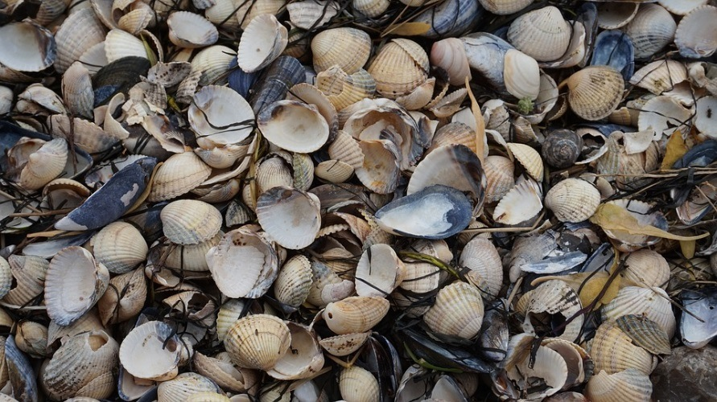
Character: The aqua-culturist (farmer of fresh and sea water species)
Heidi is an aqua-culturist. She studied A levels in biology and chemistry and took a degree in Marine Ecology at Plymouth University. She loved the course so much that she undertook post graduate study for a year in New Zealand, where she researched sea water molluscs. She really loved the country. She now farms green lipped mussels in the bay around Marlborough. She loves being ‘hands on’ in her job! She has been doing this for 5 years and her business is expanding all the time. In deed, this reflects that aqua-culture is the fastest growing sector of the world food economy.
Challenge: Her farm is producing enormous amounts of waste shells every day. Environmental rules mean she cannot return the shells to the sea and it is very expensive to dispose of them in landfills because they must be free of living matter. How can she find a cheap way of disposing of them which does not damage the environment?

Slide 7
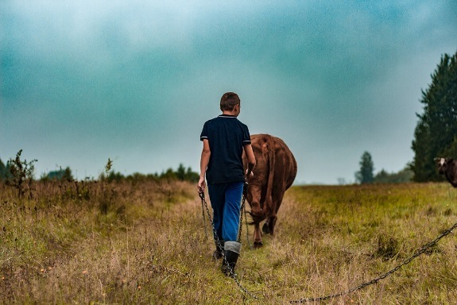
Character: The agronomist
Matthew was always interested in science at school. He decided to study for a degree in ecology with biology and now works as an agronomist, a job which requires a strong science background.
An agronomist uses scientific knowledge about plants and soil to grow the best possible crops. The role involves dealing with farmers on a daily basis, looking at their fields and helping them plan what to plant. Matthew offers advice on agrochemicals, fertiliser, seed, game cover and novel solutions like variable rate fertiliser or drilling.
Matthew loves his job as he gets to work outside a lot, often in the sun, and doesn’t spend much time in his office. He thinks the very best bit is watching a crop growing and knowing that it’s his expertise that helped produce it. He also loves the variety in the work and the opportunity to meet new people.
http://www.brightcrop.org.uk/Explore-your-career/Grow-It/Matthew-Taylor.aspx#.WJ3W12e9SU

Slide 8
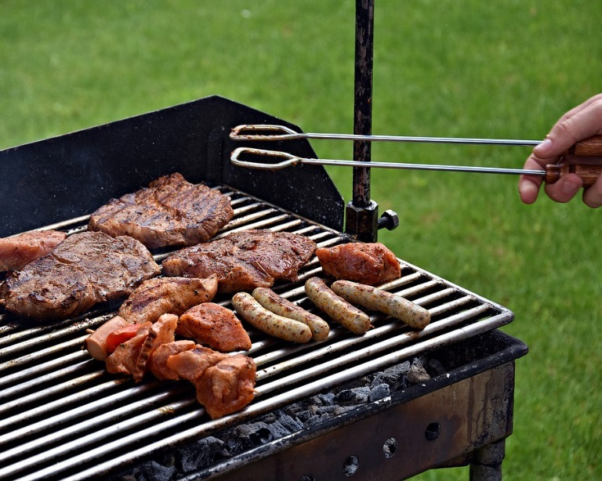
The scene: A barbecue
Sue, Heidi and Matthew meet at barbeque at the local beach. Sue and Heidi are discussing the challenges they are facing to keep down costs so that their businesses continue to be profitable.
Matthew overhears the conversation and thinks he can help both of them solve their problems at the same time. He realises that mussel shells are rich in lime (calcium carbonate) and that this is the perfect fertilizer for grass growth.

Slide 9
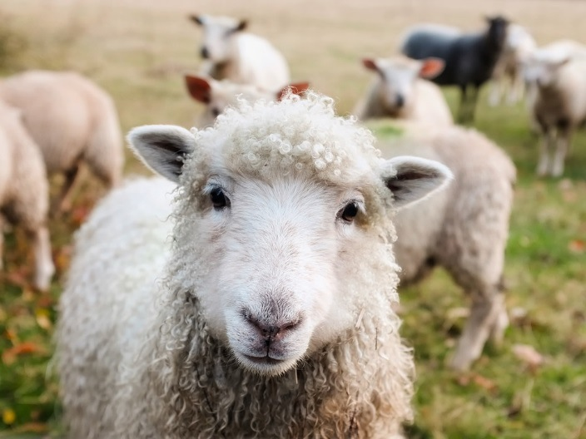
A solution perhaps …
Heidi arranges for her waste shells to be taken to Sue’s farm. Sue now has a mountain of shells which she can crush and use as a top dressing for the grass and Heidi has no waste to dispose of. A win-win solution.

Slide 10
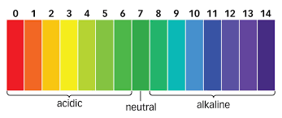
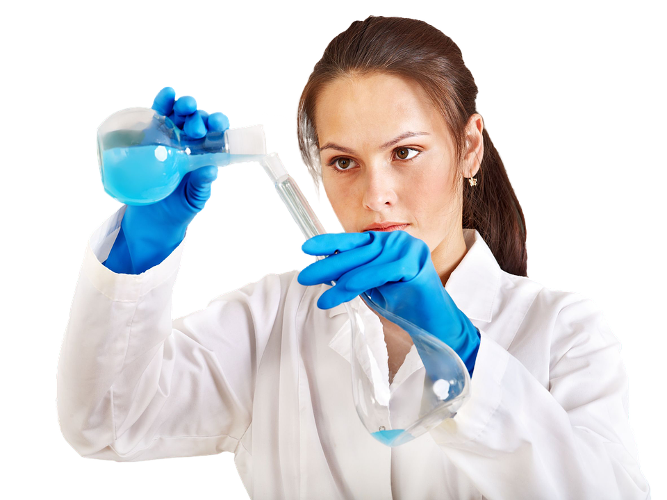
Not quite! You have a mission..
There is a problem. How will the grass absorb minerals if the soil becomes too alkaline?
How will calcium carbonate affect the pH of the soil?
You must assume the role of a chemist. You must carry out an experiment to find out how two types of lime, slaked (calcium hydroxide) and ground (calcium carbonate) affect soil pH and advise Sue on whether its safe to use the waste shells as fertiliser.
TeacherExpt:Neutralisation – ‘curing acidity’ - Learn Chemistry Wiki
Notes:
Discussion here about what pupils know about these chemicals and about measuring pH.

