Slide 1
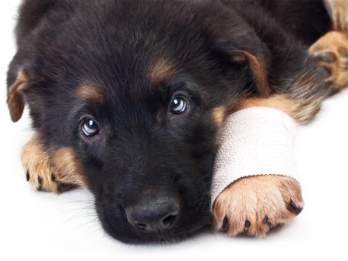
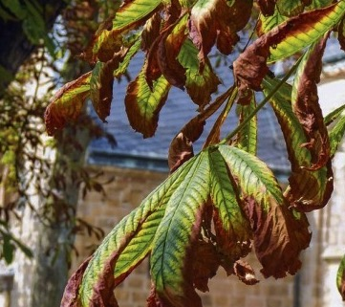
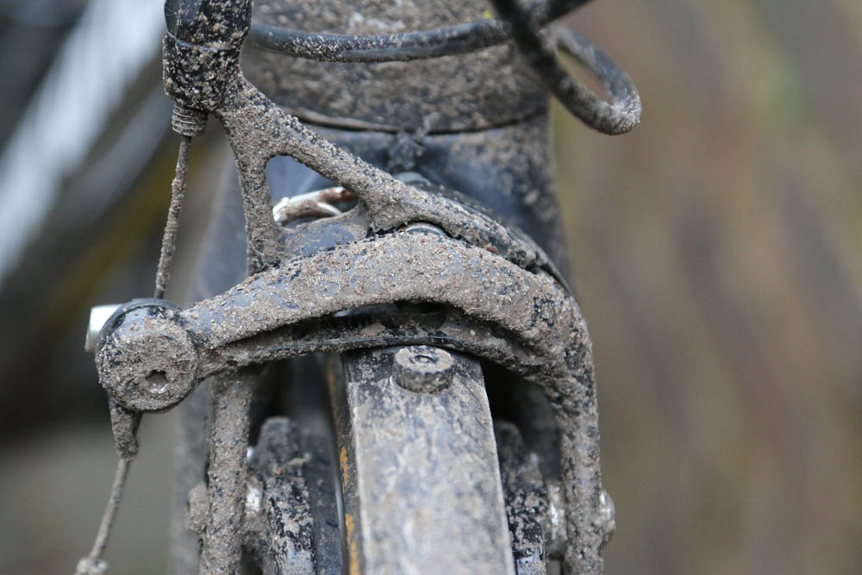
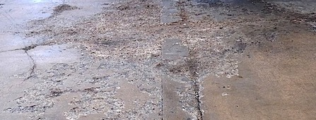
Road salt
This project has received funding from the European Union’s Horizon 2020 research and innovation programme under grant agreement No 665100.

Slide 2
One morning in the city hall of (XXX) ...
Insert a photo of your local town hall here
Notes:
Exchange picture, using the one of your local city hall;
replace „(XXX)“ by your city‘s name

Slide 3
In the mayor‘s office

Slide 4
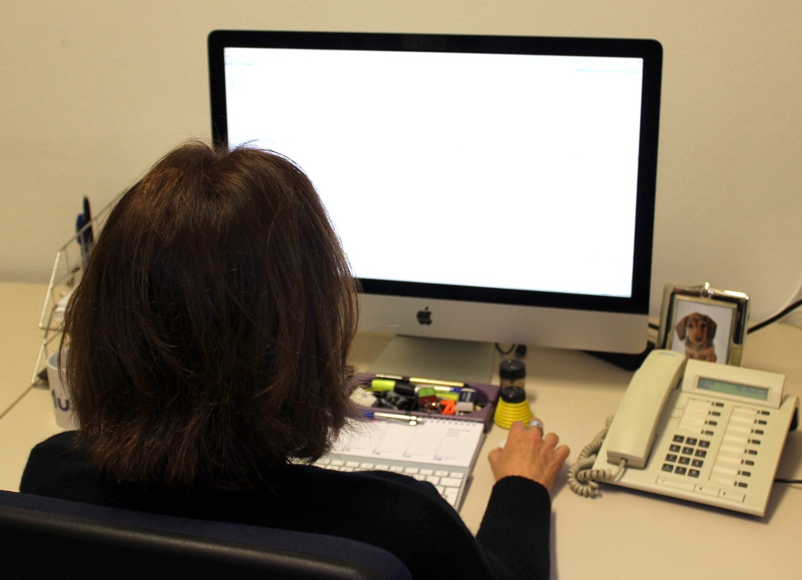
Let‘s have a look... who has written?

Slide 5
mayor@(XXX).com
(4)
Tree dieback in (XXX) 23.01.2017
My bike is broken 23.01.2017
Million euros damages 23.01.2017
Don‘t you think of our animals?! 23.01.2017
Appointment 23.01.2017
Doodle for meeting 23.01.2017
Meeting 10 am 23.01.2017
Final report 2016 23.01.2017
Meeting 13.12.16 23.01.2017
Copyright 23.01.2017
Circular mail city administration 22.01.2017
Training „Home office for beginners“ 22.01.2017
Lunch Meeting 22.01.2017
New Laptop 22.01.2017
Financial Report 2016 22.01.2017
Conference dinner 22.01.2017
Vacation plan 22.01.2017
Save the date: EU meeting 22.01.2017
If you have read the four email please click on the arrow
Notes:
Replace (XXX) twice. You might also want to change the German mailbox.
During the presentation, you can click on the emails (link to the messages/slides)

Slide 6
Dear Mayor,
Unfortunately, I realised that the trees and bushes of our wonderful alley in (XXX) show ugly brown stains on their leafs. I have observed this phenomenon for some time now and I wonder if this damage could be caused by road salt. I‘m woried that these old friends could die off! I expect that you will do your best to prevent this!
With best regards,
Heinrich Kiel, citizen of (XXX) and friend of trees
https://www.bauhof-online.de/d/auswirkungen-von-streusalz-auf-die-gesundheit-von-strassenbaeumen/
back
Notes:
Replace name and (XXX)
During the presentation, you have to click on the arrow to go back to the email page

Slide 7
Hello Mayor,
I just wanted to say that your road salt caused my dog‘s injuries!!11!
It is disgusting that you put out such poison in our streets. Did you ever think what damage you do to our beloved pets?! ☹
Regards,
Sabine B. and Bobo
https://www.wunsch-hund.de/tipps/pflege/130-pfoten-pflege-allgemein
back
Notes:
Replace names

Slide 8
Dear Mrs. Mayor,
My name is Nick Schneider. I ride my bike to school everyday. Since it has been very cold outside, I have noticed some red stains on my bike. Me and my parents believe it has to do with the road salt that‘s been pit out in the streets. If that should be the case, I was wondering if there are no possible ways to keep the roads clear of ice. That would also be less harmful to cars.
Best wishes,
Nick Schneider
back
http://www.cyclingweekly.com/fitness/training/winter-bikes-really-need-one-147811
Notes:
Replace name

Slide 9
Dear Mrs. Mayor,
My name is Meinhard Karlson and I live in (XXX-suburb). I am a keen lover of the historic buildings in our region and only recently visited the Cologne Cathedral. There my wife and I noticed some damage in the floor panels ot the outer building. We assume that these damages could have been caused by road salt. We were wondering if our beautiful cathedral and the buildings of (XXX) are at risk, too? Have you ever considered such a risk?
My wife and me would very much appreciate your feedback on this matter.
Kindest regards,
Meinhard and Gerda Karlson
back
https://www.mygreenimpressions.com/blog/dont-damage-your-natural-stone-walkways-with-rock-salt
Notes:
Replace names

Slide 10
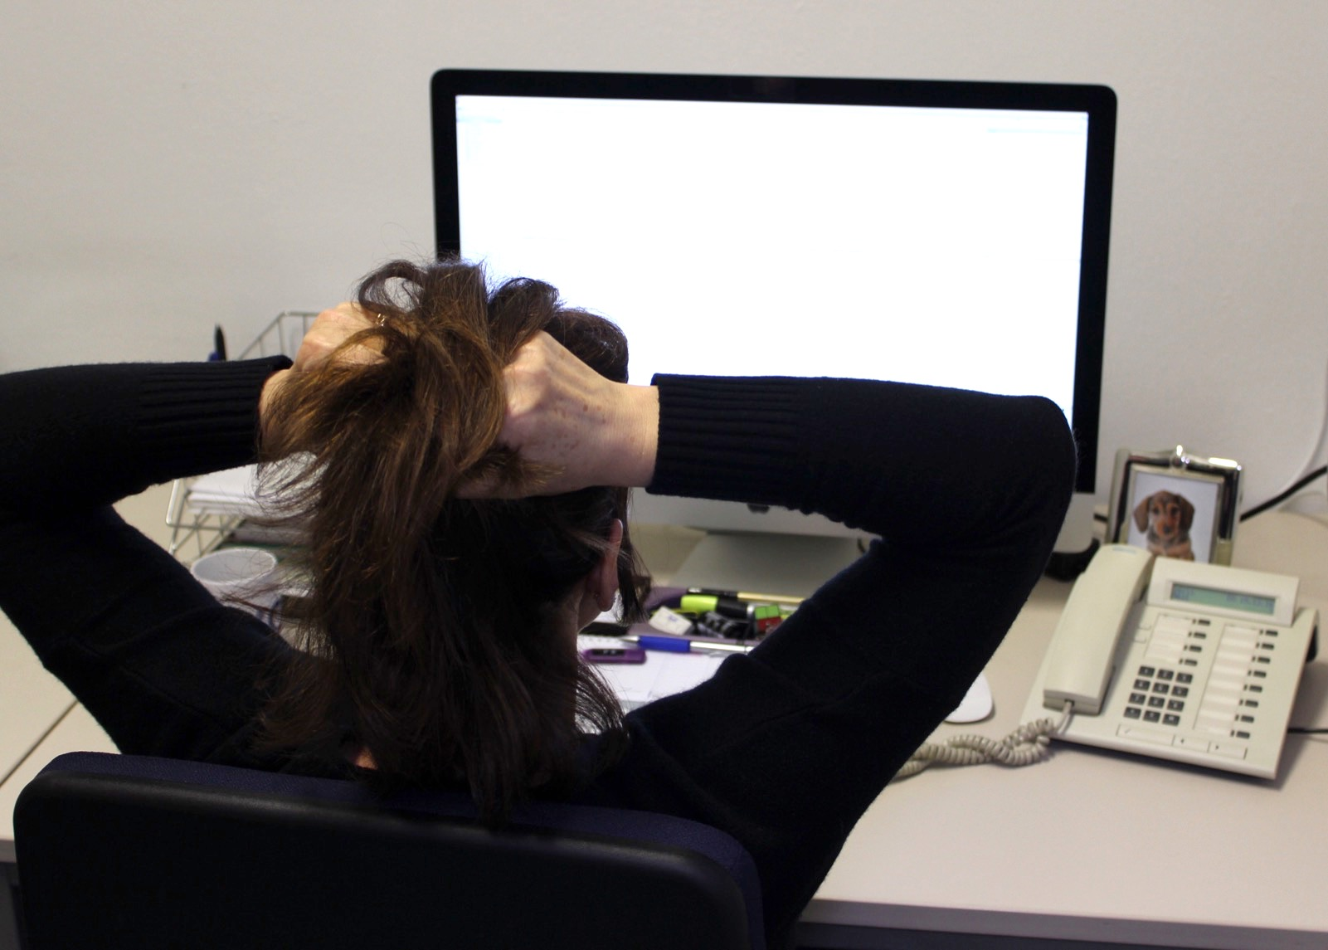
What‘s going on here?!

Slide 11
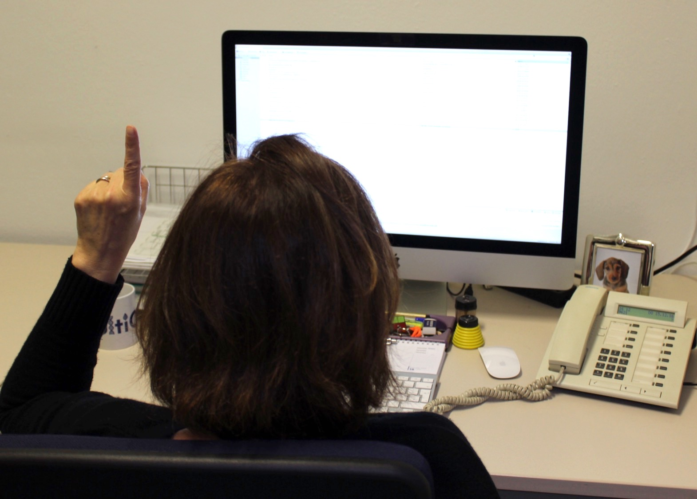
Oh wait... I got that offer for an alternative to road salt last Friday.

Slide 12
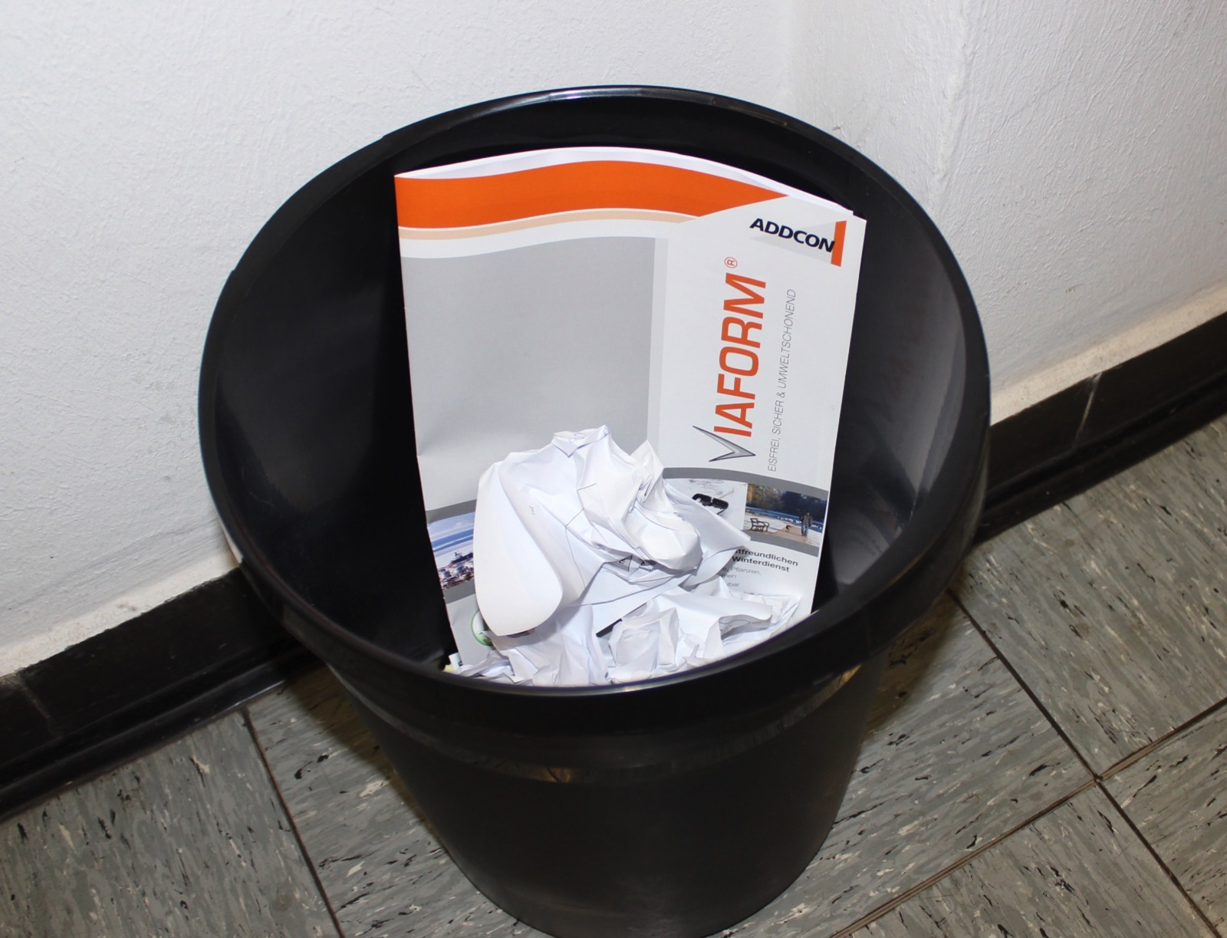
Unfortunately, it was much more expensive...

Slide 13
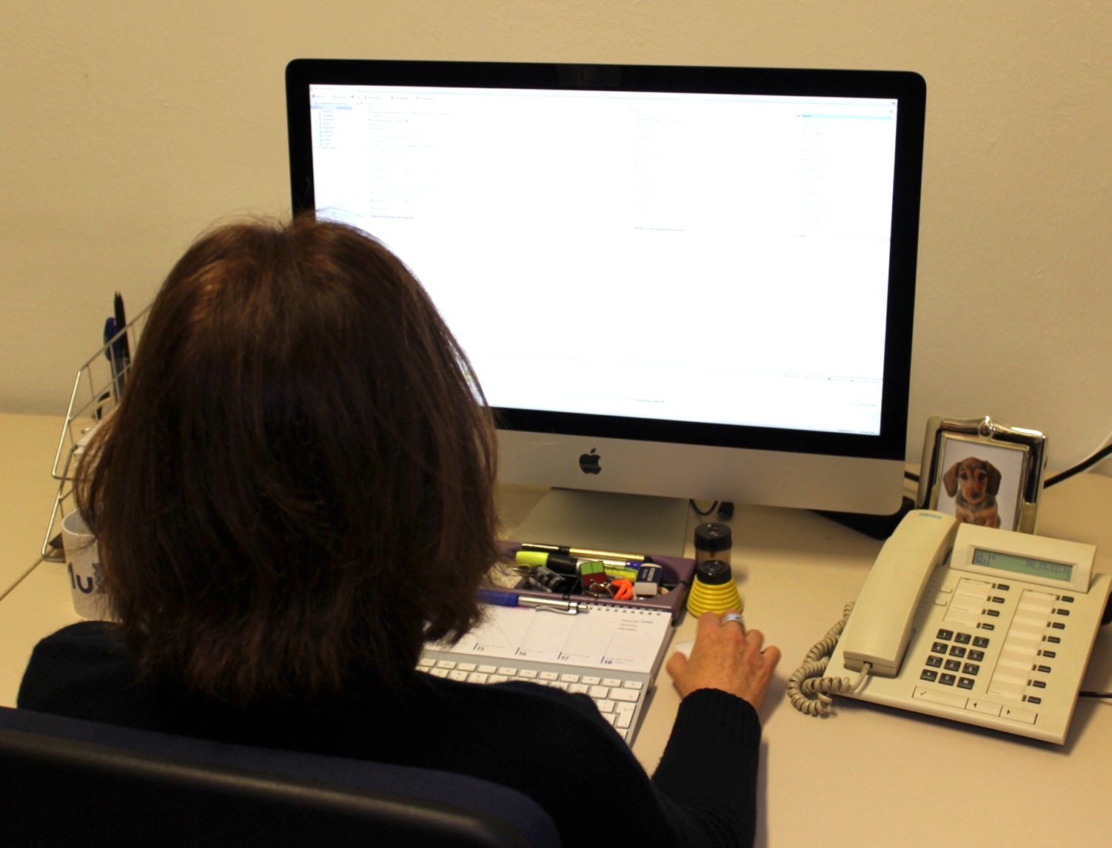
Hm... but after all these emails, we should check this option.

Slide 14
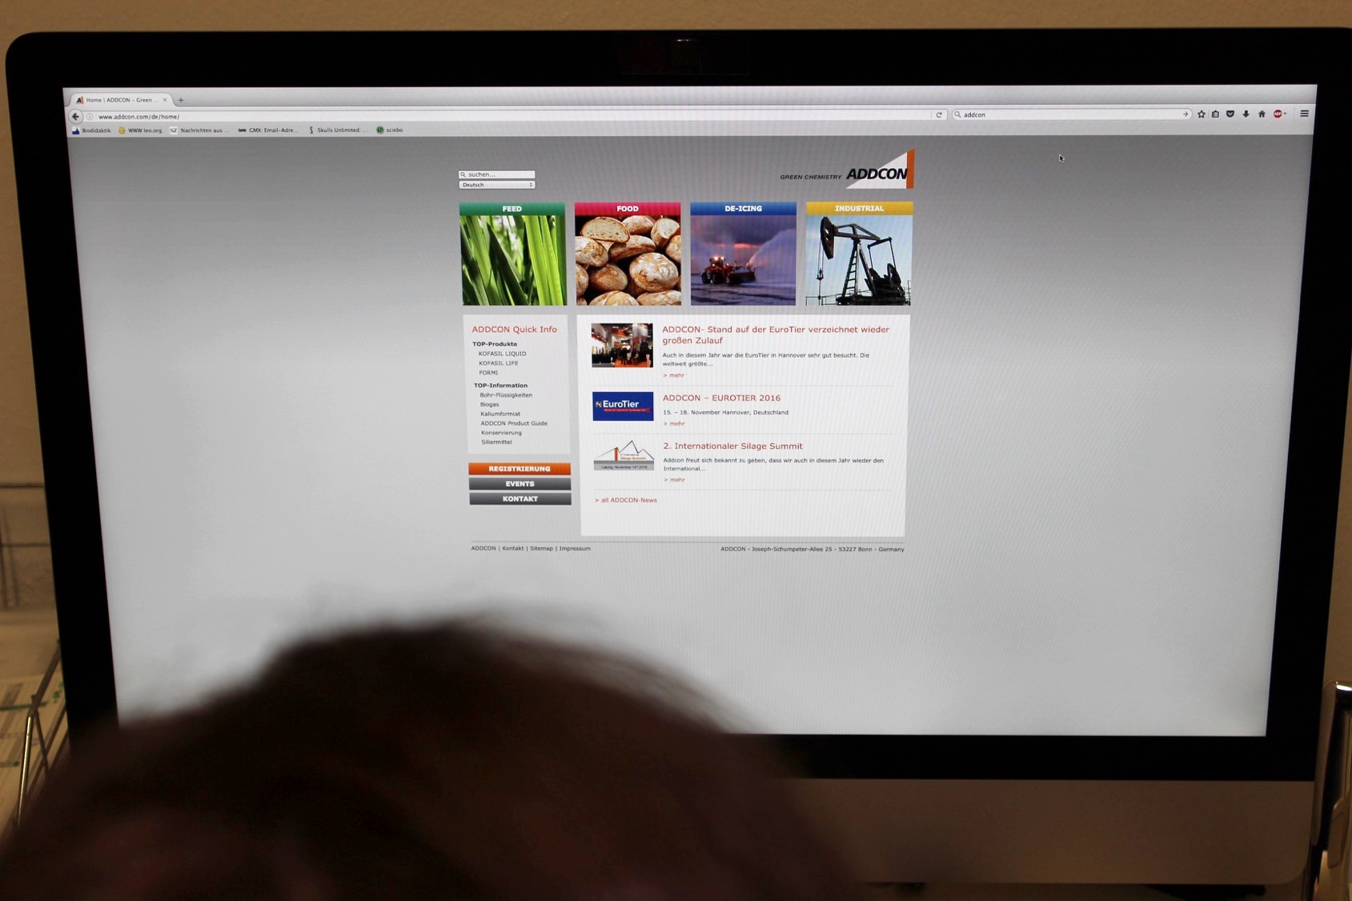
Let‘s have a look what this is all about...

Slide 15
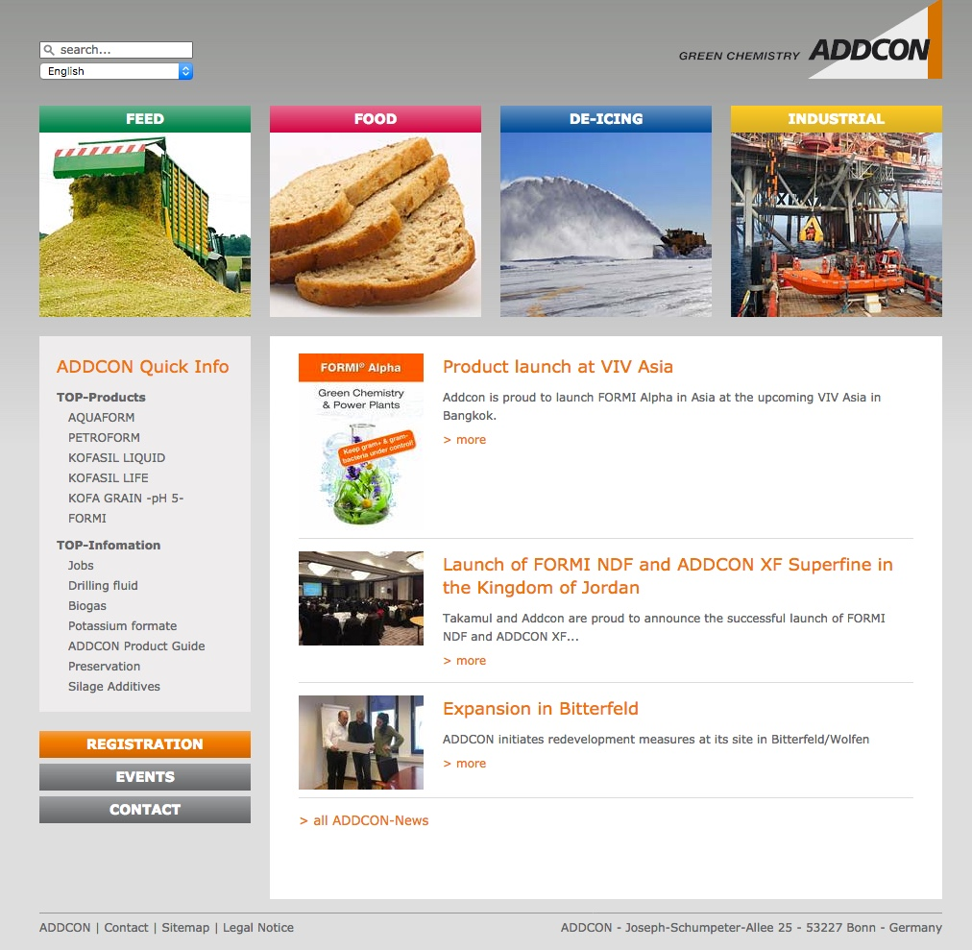
This company seems to have several branches: Feed, Food, De-Icing and Industrial.
Notes:
You can find the original homepage here: http://www.addcon.com/en/home/
There is also a finnish version!!! Just use screenshots to replave the picture.

Slide 16
What do they write about their alternative to road salt...

Slide 17
Find out about ADDCON‘s alternative to road salt by clicking the right picture!
Notes:
During the presentation: Only by clicking on „De-Icing“, you will get to the right text ;-)

Slide 18
Sorry, that‘s incorrect. Try it again! ☺
back
Notes:
If you do not click „De-Icing“ but another picture instead, you will end up here. Click on the arrow to go back.

Slide 19
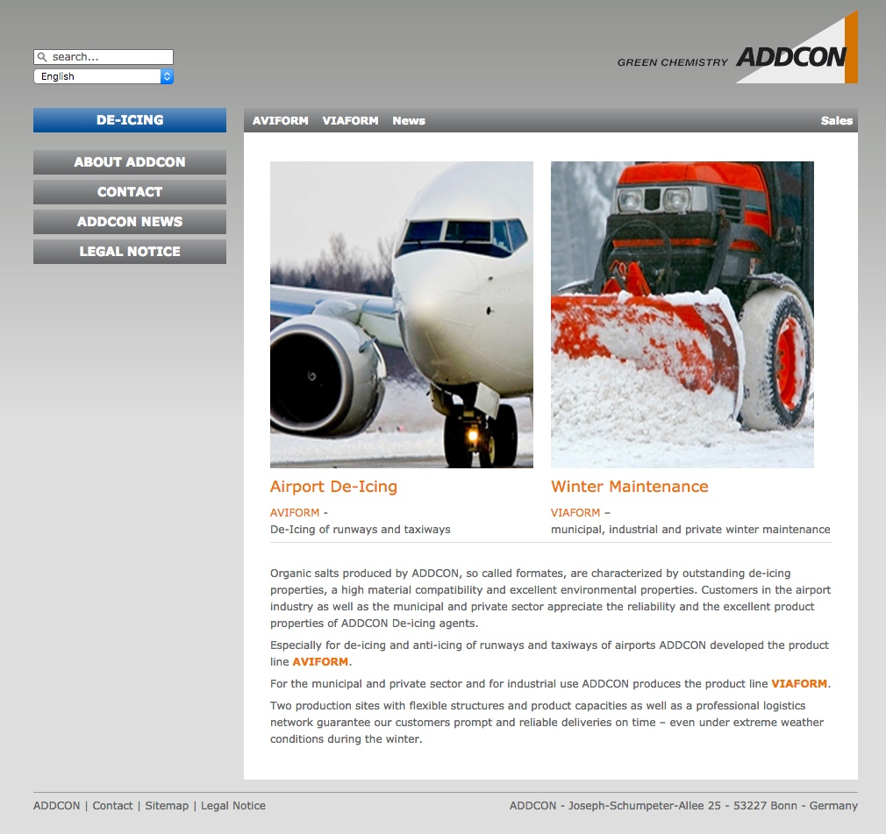
Read the text.
(next slide)

Slide 20
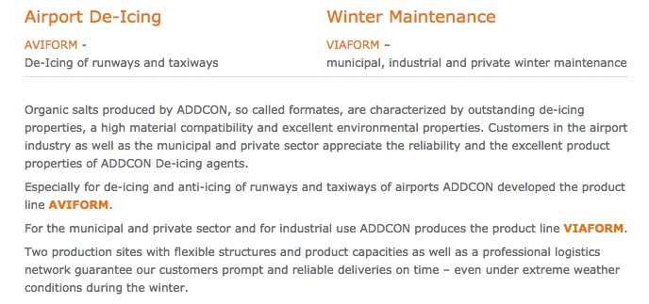

Slide 21
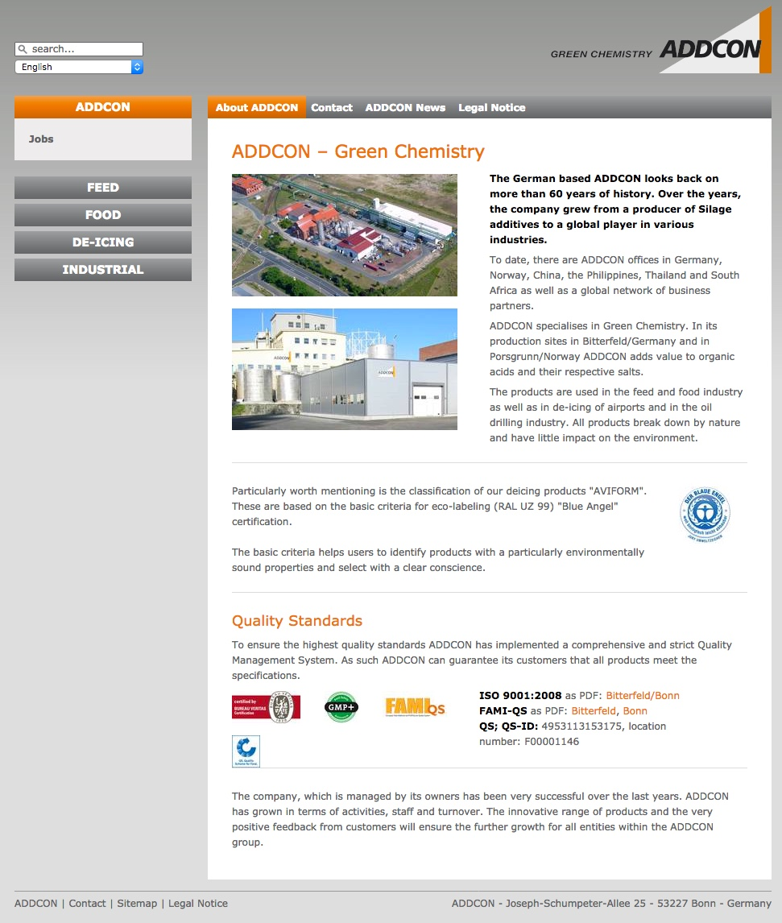
Find out about people working at ADDCON by using the material in envelope A!
Notes:
Hand out the envelope A (one per group of 4 students)
In the end, ask them to justify their choice (Why do you think that this person really works at ADDCON? Why do you think that this person is fictitious?)
Information: Bernd Kochannek and Celina Heider are people working at ADDCON. The other two profiles relate to existing persons, too – they do not work for ADDCON though and their names have been changed.

Slide 22
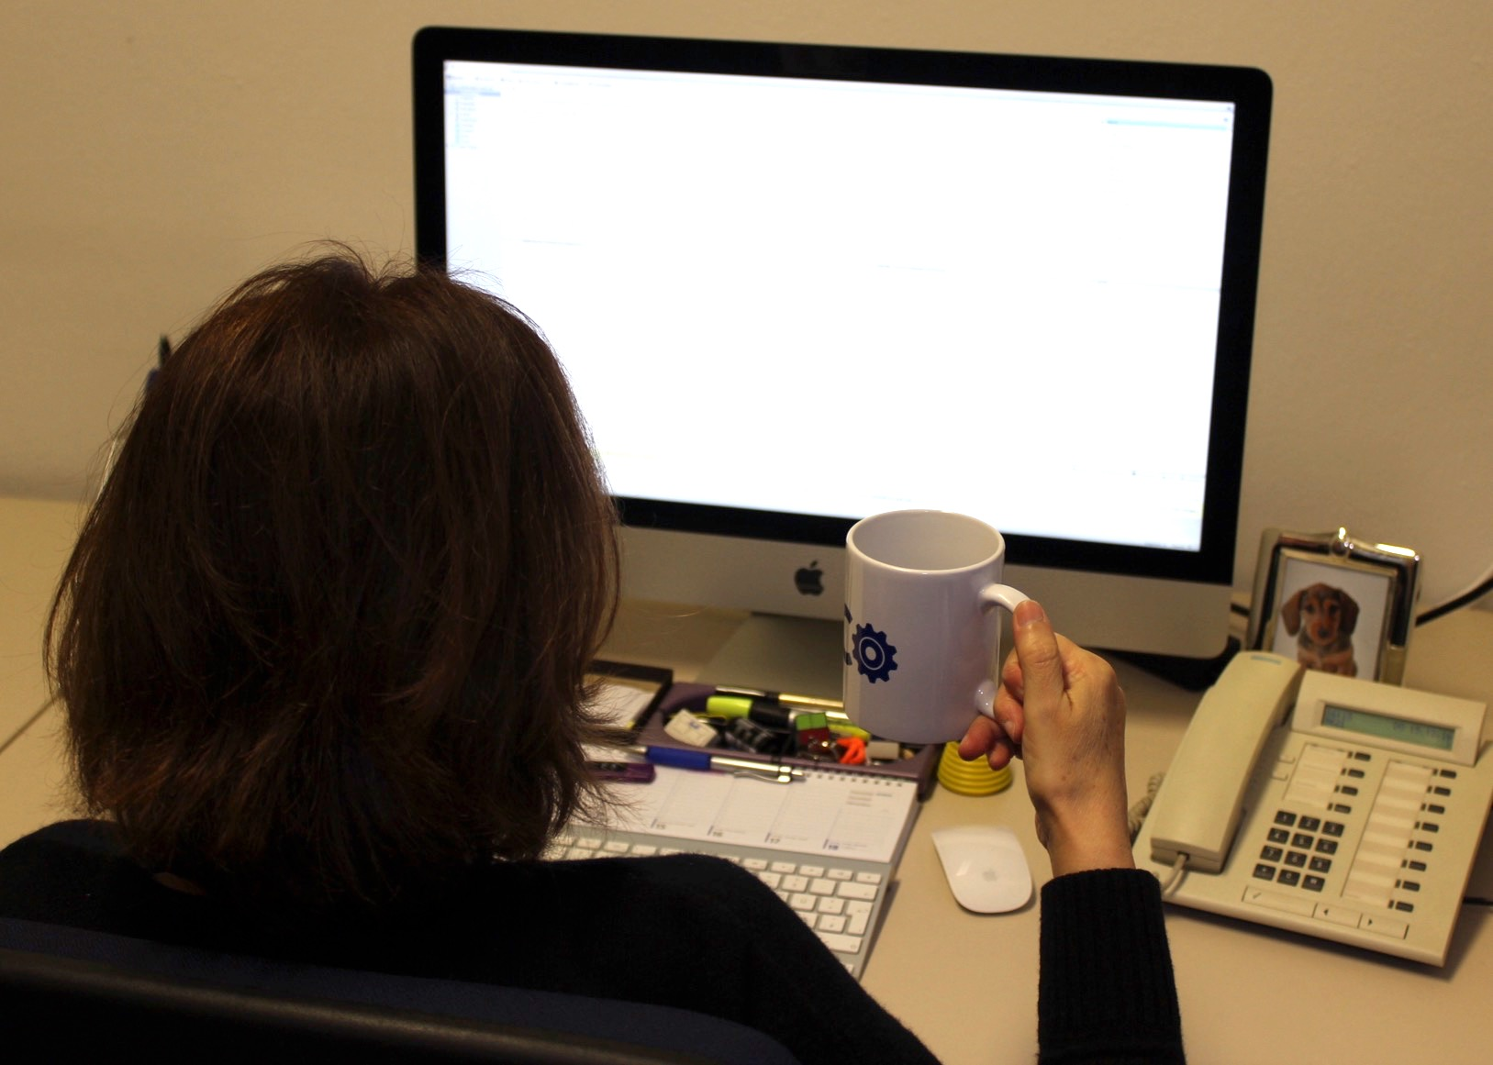
Well, maybe this product really could be an alternative to road salt.

Slide 23
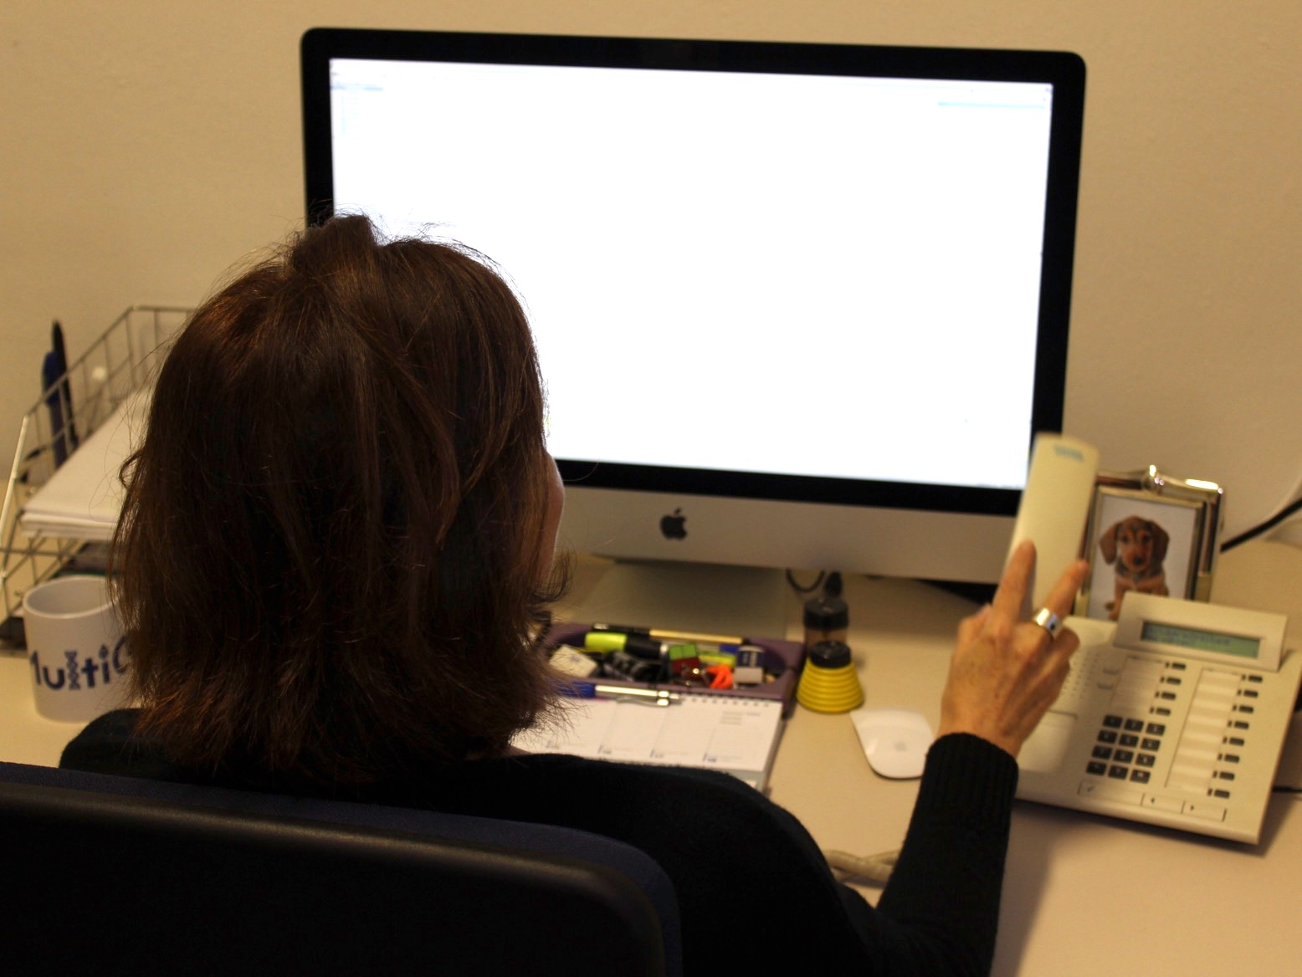
I will ask my sectretary to arrange an appointment with the experts. They should test this product.

Slide 24
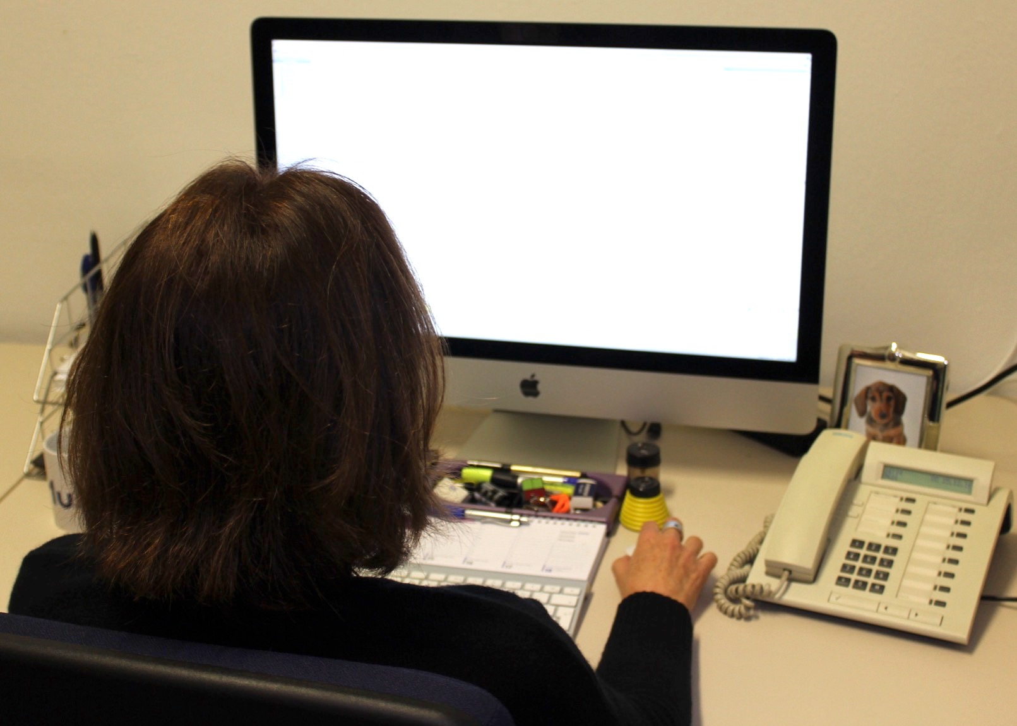
Only after these tests, we can take an informed decision.

Slide 25
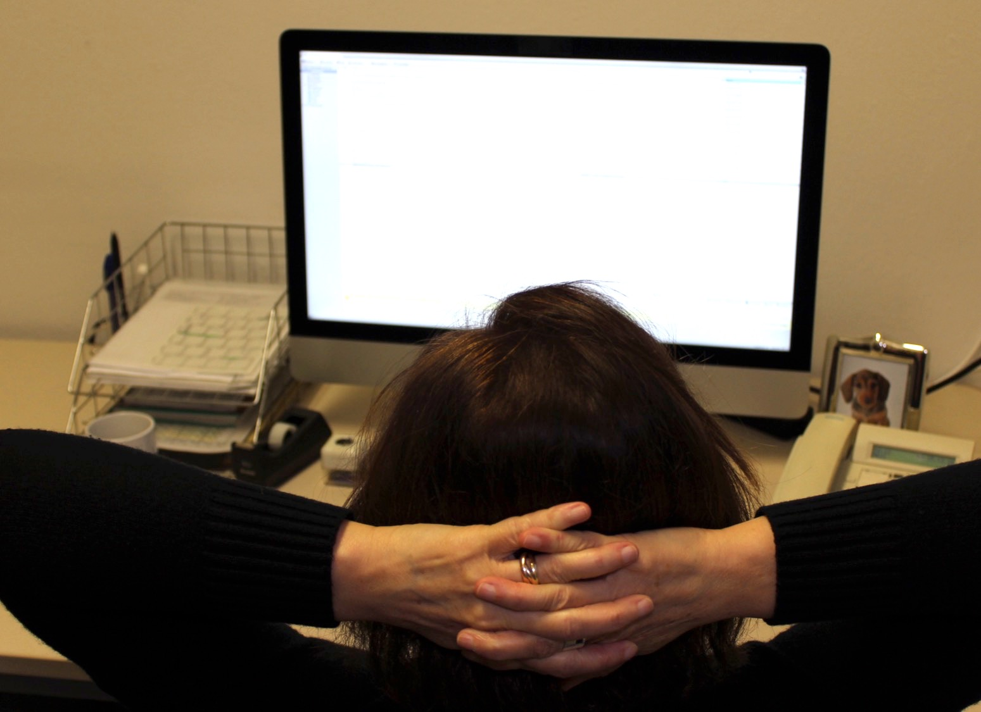
Well well, maybe this will solve all these problems at one go...we shall see.

Slide 26
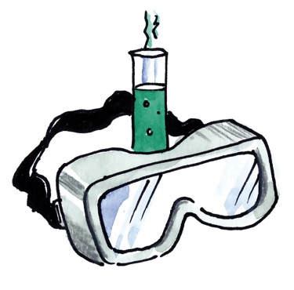
You have been chosen as experts to test the alternative to road salt very carefully.
How could you test this product? Remember the four emails, while planning your experiments.

