Slide 1
Save the polar bears!
This project has received funding from the European Union’s Horizon 2020 research and innovation programme under grant agreement No 665100.

Slide 2
Teaching Unit: Heat Transfers
Scenario: Save the polar bears!
This project has received funding from the European Union’s Horizon 2020 research and innovation programme under grant agreement No 665100.
https://multicocy.wordpress.com/
http://www.multico-project.eu/

Slide 3
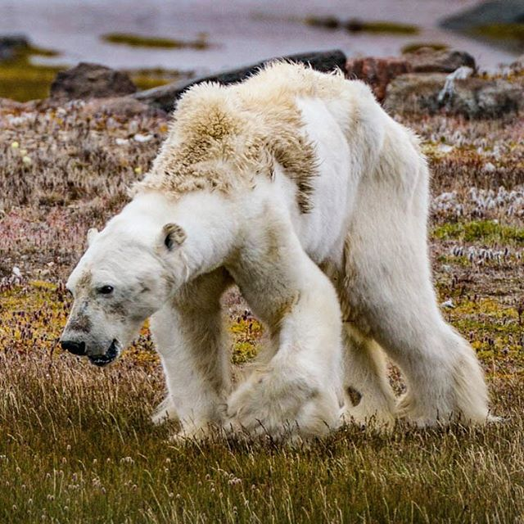
Save the Polar Bears
Notes:
Taken by the Canadian photographer Paul Nicklen for National Geographic

Slide 4
Polar Bear video
Notes:
https://d1o50x50snmhul.cloudfront.net/wp-content/uploads/2013/08/dn23994-1_800.jpg
https://www.youtube.com/watch?v=_JhaVNJb3ag
https://www.youtube.com/watch?v=I5H4GHkT5wI

Slide 5
Social issue
Climate change threatens polar bears’ life
Rise of the temperature
Sea ice melts
Polar bears are starving to death – difficult to find seals
Illegal to feed polar bears
Climate change affects the entire planet

Slide 6
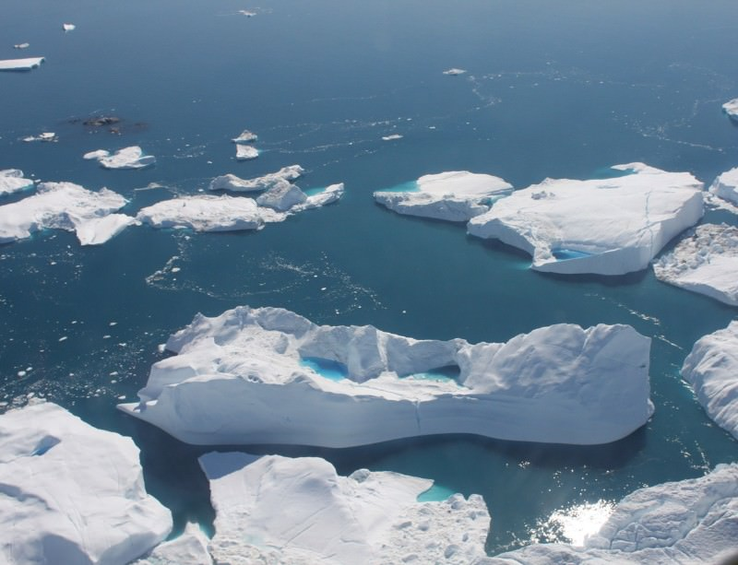
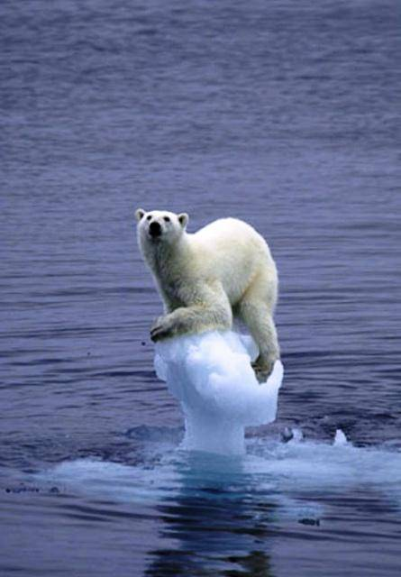
Arctic Ice melts
Notes:
Ice melts https://d1o50x50snmhul.cloudfront.net/wp-content/uploads/2013/08/dn23994-1_800.jpg
Bear on ice https://www.bibliotecapleyades.net/ciencia/ciencia_globalwarmingpseudo38.htm

Slide 7
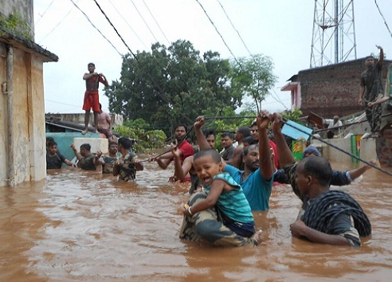
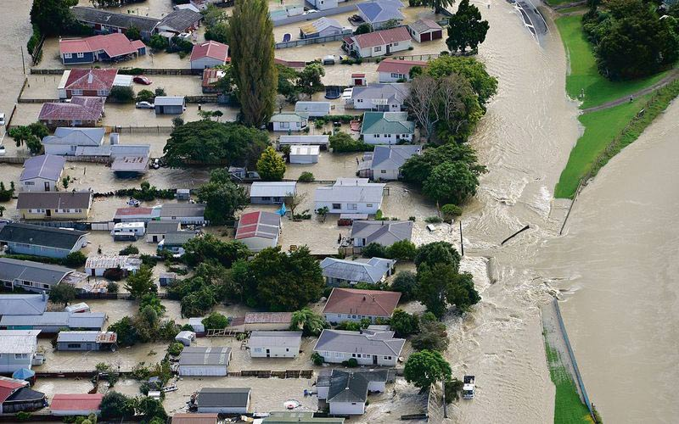
Floods
India 2017
New Zealand 2017
Notes:
Left: India http://www.india.com/news/india/monsoon-2017-rains-wreak-havoc-in-gujarat-assam-flood-situation-improves-2345458/
Right: Edgecumbe - New Zealand https://teara.govt.nz/en/photograph/46848/edgecumbe-flood-2017

Slide 8
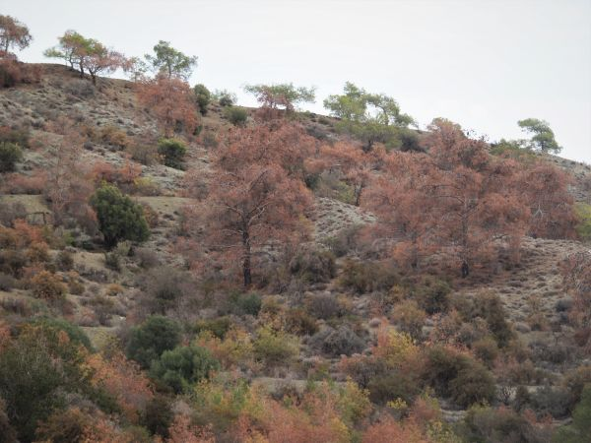
Droughts
Cyprus 2017
Northern Kenya 2017
Notes:
http://www.circleofblue.org/2017/world/kenyas-drought-worsens-wake-average-rainfall-october-mid-december/

Slide 9
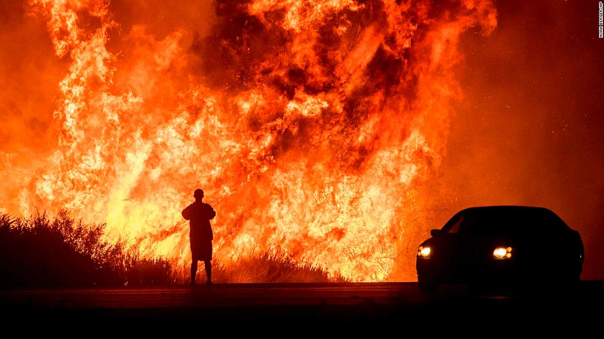
Fires
California 2017

Slide 10
Notes:
https://antinuclear.net/2017/08/11/inquiry-into-the-security-ramifications-of-climate-change-warning-on-australias-risks/

Slide 11
We sit cozy in our house without thinking that this would accelerate climate change…
Notes:
Even though we don’t live near Canada, we can affect polar bears’ life.

Slide 12
The energy we use to heat and cool our houses comes from power plants that use mainly fossil fuels.
Notes:
Video about using a lot of energy for cooling up to 1: 15’ https://www.theguardian.com/environment/2015/oct/26/cold-economy-cop21-global-warming-carbon-emissions

Slide 13
Fossil fuels are burnt to produce energy and this increases carbon dioxide levels in the atmosphere which consequently increases the global temperature.

Slide 14
Global surface temperature from NASA
1884
2016
Data source: NASA/GISS Credit: NASA Scientific Visualization Studio
Notes:
https://climate.nasa.gov/vital-signs/global-temperature/

Slide 15
What can we do about it?
If our houses were better insulated, less energy would be required for heating and cooling reducing thus fossil fuel use and carbon dioxide emissions thus negative impact on the environment.

Slide 16
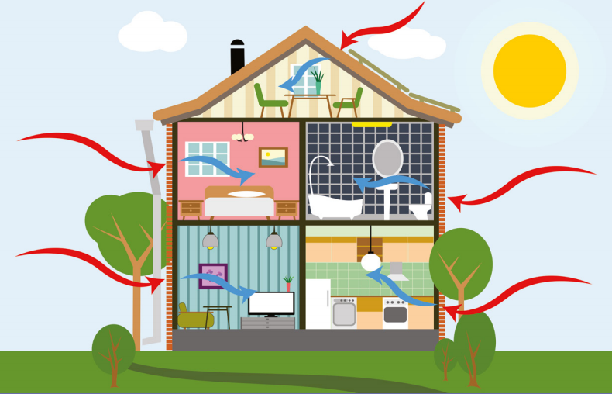
Possible solution
To design and build energy-efficient houses as to address global warming and save money as well.
Notes:
Discuss what energy-efficient house is
Image http://alchinlong.com/news-and-events/news/whitepaper-designing-energy-efficient-homes-with-minimal-power-bills/

Slide 17
Architects and Engineers design energy-efficient houses
Notes:
http://www.studioarch17.com/

Slide 18
Provides
architecture services
structural study services
energy efficiency study services
environmental impact study services supervision
website:www.studioarch17.com

Slide 19
Name – Position | Background | Expertise | Skills
Senior architect | Architect engineer Civil engineer | Energy efficiency of buildings | Leadership, management, analytical thinking, communication, problem solving, creativity, knowledge of design software, computer skills, up to date, understanding of heat loss and structural engineering
Energy consultant | Physicist | PhD on Mechanical and Manufacturing Engineering | analytical thinking, communication, problem solving, creativity, knowledge of design software, computer skills, up to date, understanding of environmental awareness, understanding of heat loss and structural engineering
Architect engineer | Architect engineer | Building design | creativity, knowledge of design software, computer skills
Notes:
next slide)

Slide 20
Mission
Assume the role of architect and engineer to design, create (and test) energy-efficient model-houses.
What materials should be used to make our houses energy efficient (keep our houses warm during winter and cool during summer)?
Notes:
The basic science behind this is heat transfer and application in engineering.

