Slide 1
Two-wheeled mission
This project has received funding from the European Union’s Horizon 2020 research and innovation programme under grant agreement No 665100.

Slide 2
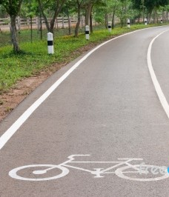
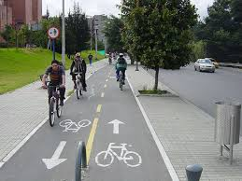
Two-wheeled mission
This project has received funding from the European Union’s Horizon 2020 research and innovation programme under grant agreement No 665100.

Slide 3
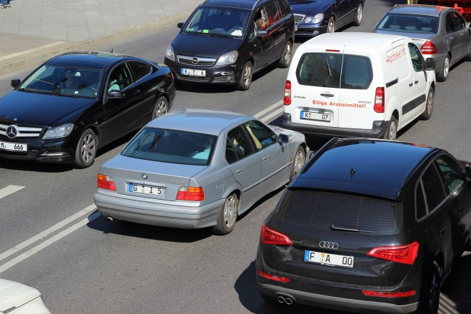
Road congestion!
Traffic jam causes CHAOS in the city centre of Nicosia every morning.
Impatient drivers yelling at each other while beeping their horns.
Noise
Pollution
Wasted time
Frustration

Slide 4
Green Decision
The Association of Environmentalists decides to take action as to protect both,
the environment and the human being.

Slide 5
IDEA
Developing a Biking Route!
The president of the association sends out a letter to mayor recommending the development of a bicycle route in the city centre.
The mayor gets excited and assigns this project to the transportation engineer.

Slide 6
What do I know about Transportation Engineer
Educational background (studies)
Working conditions
Job duties
Working place
Skills required
How does the transportation engineer could help to solve the issue presented in the scenario? ____________________________________________________________________________________________________________________________________________________________________________________________________________________________________

Slide 7
Video about Transportation Engineer (5’)
https://drive.google.com/open?id=0BxfbENmto0ZqSURfNXdPdFU5T2s
Notes:
Video – Sources
https://www.youtube.com/watch?v=hAWlghloJFU 0:04 – 0:30
https://www.youtube.com/watch?v=eGp1s40Fxj0
0:53 – 2:07
https://www.youtube.com/watch?v=scqBHHO_4mA Presentation of transportation engineer
http://www.eng.ucy.ac.cy/transporteng/

Slide 8
So, the transportation engineer in order to ensure a safe environment for the cyclist, set the parameters for the design of the biking route and suggested 2 biking routes.

Slide 9
Parameters to consider for the biking route
1. Value for money
2. Width: 1. 6 - 2 m.
4. Short route based on the following maximum speed limits:
10 km/h: 600m before and 600m after roundabout
10 km/h: 400m before and 400m after schools
3. Length: 5 – 8 km.
40 km/h: any other street
8 km/h: intersection Iosif Hadjiosif street and Athalassas Avenue until the intersection with Stavrou street

Slide 10
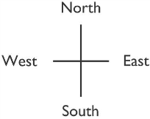

Slide 11
Biking Route 1 Description
Staring point: Presidential Residence Roundabout
Continue south and take the first turn on the left
Continue going straight (in 400m you will pass a school on the right hand side) and continue south-east towards Lemesos Avenue
Continue south-west until the 1st intersection and then turn left
Continue south (in 2km there is a school on the left hand side) until the next intersection and turn left
Continue going straight until you reach the first roundabout. From here, go straight towards the second roundabout
Ending Point: Hospital Roundabout
Width: 1.8 – 2 m
Cost of construction: 35 000 euro

Slide 13
Biking Route 2 Description
Staring point: Presidential Residence Roundabout
Continue south and take the first turn on the left
Continue going straight (in 400m you will pass a school on the right hand side) and continue towards the first intersection (Athalassas Avenue and Iosif Hadjiosif) and turn right
Continue south, pass the 2nd intersection (Stavrou and Iosif Hadjiosif) (in 400m you will pass a school on the left hand side) and on the 3rd intersection turn left
Continue going straight until you reach the first roundabout. From here, go straight towards the second roundabout
Ending Point: Hospital Roundabout
Width: 1.5 – 1.8 m
Cost of construction: 38 000 euro

Slide 14
Which biking route is the best?

Slide 15
Mission
The transportation engineer has to choose a biking route that is value for money and of course safe for the cyclists and the drivers.
However, it is more critical to choose the shortest route, not necessarily the shortest in length but the one that takes less time to travel from the starting to the ending point.

Slide 16
Mission
The transportation engineer has to choose a biking route that is value for money and of course safe for the cyclists and the drivers.
However, it is more critical to choose the shortest route, not necessarily the shortest in length but the one that takes less time to travel from the starting to the ending point.
Be the
Transportation Engineer!
Study the maps, measure the length, add the speed limits and try to find the ‘shortest’ biking route based on the parameters given.

Slide 17
Steps
Complete the Parameters Table
Some information are given in the descriptions of the biking routes.
Hint: In order to measure the length of each route you should check the scale on the map.
Complete the Table of maximum speed limits
Add the speed limits according to the information given in the Parameters to consider for the biking route
Measure the total time for each biking route
Hint: use the speed = distance/time formula
Fill in the total time for each biking route on the Parameters Table
Evaluate each parameter for each biking route from 1 to 5 (1=lowest value and 5=highest value)
You can use any number as many times as you want.
The biking route with the highest rating wins!

Slide 18
Parameters Table
Parameters | Biking Route 1 | Rate | Biking Route 2 | Rate
1. Cost of construction
2. Width
3. Length
4. Total time to travel from the starting to the ending point
Total Rate

Slide 19
Table of maximum speed limits
Biking Route 1 |  |  | Biking Route 2
Length 1cm: 200m | Speed km/h | Time (minutes) | Length 1cm: 200m | Speed km/h | Time (minutes)
Starting point Α - |  |  | Starting point Α -
Total time |  |  | Total time

Slide 20
What do I know about Transportation Engineer?
Educational background (studies)
Working conditions
Job duties
Working place
Skills required
Eventually, how do you think the transportation engineer could contribute to solve this issue? ____________________________________________________________________________________________________________________________________________________________________________________________________________________________________

