Slide 1
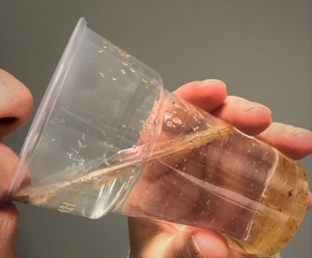
*Local city* drinking water is polluted People sent to hospital
This project has received funding from the European Union’s Horizon 2020 research and innovation programme under grant agreement No 665100.

Slide 2
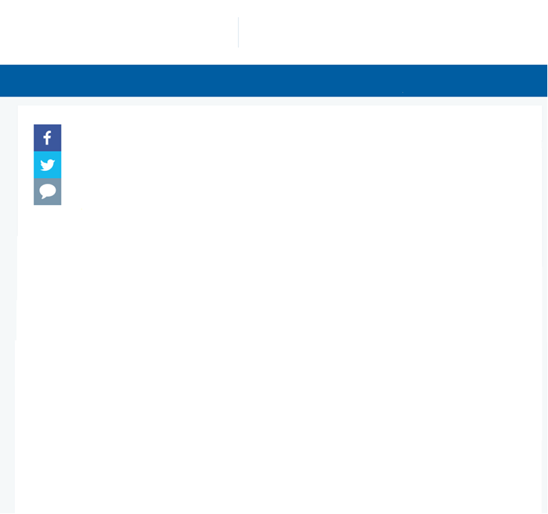
LOCAL NEWS PAPER
1.1.2018
Front page | News | Themes | Events | Search Customer service
*Local city* drinking water is polluted
People sent to hospital
“Drinking water in the whole city is undrinkable. Water includes insoluble and soluble impurities.” says the City’s water service supervisor. “We need all the help we can get to solve this problem.”
Scientists are concerned of the effects of the climate change and air quality on declining water quality. This current problem might be partly caused by long-term pollution.
Notes:
*NOTES FOR TEACHER
You can edit the news paper article to suit your local city/town
Teacher shows a demonstration how polluted water comes from the tap by tricking the students by switching two glasses. One glass to pour water from the tap and another one with polluted water waiting in the sink.

Slide 3
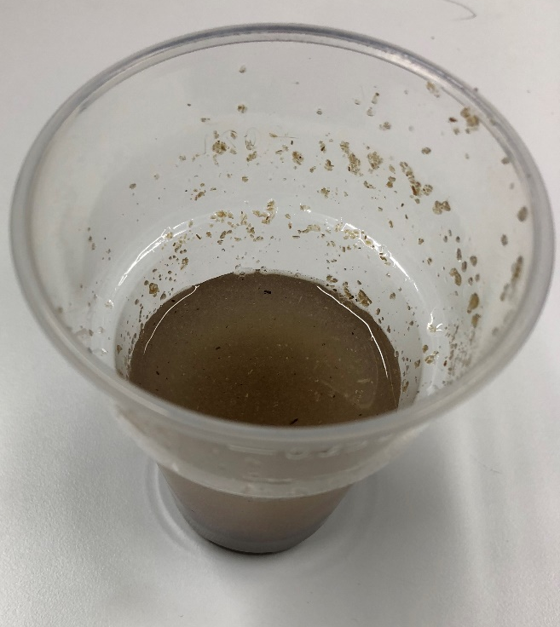
Can polluted water be purified to be drinkable again?
This project has received funding from the European Union’s Horizon 2020 research and innovation programme under grant agreement No 665100.

Slide 4
City’s water service supervisor needs your help.
Read his career story to know for what he is responsible for.

Slide 5
Service supervisor
After graduating from vocational school, I did community development technician training. In my current position I got chosen when I saw the announcement in a newspaper and applied for the job. I have work experience in diverse positions and I would like to think this helps me to understand our clients better.
Responsibilities:
My tasks at office are customer service and distributing tasks to mechanics. It is my responsibility to organise and schedule their tasks and to help them solve problems when needed. Customer service entails taking down the orders and passing them to right persons, writing orders to mechanics, checking invoices and different contract negotiations and preparing contracts. Mostly I work at the office since I have to be able to check the details and information needed always.
Every day is different and you never know in the morning what the day brings. For example, water pipes do not forewarn if they break and the situations are quickly to be reacted. I also have to get proper resources, machines and staff for fixing them quickly. We have our on-call duty every six weeks and at that time I have to be available after working hours also. I do not have to travel a lot, mainly to fairs or factories, occasionally abroad as well. On site visits I try to do daily.

Slide 6
Essential skills in my job:
Social skills
Cooperation and organisatorial skills
Continuous learning to update needed information
Problem-solving skills
Adaptability to surprising situations
What I need to know in my job:
Water maintenance regulations
Technical knowledge

Slide 7
You have the task to solve the purification problem: to separate insoluble and soluble parts in water.
These kind of problems the chemists solve. Read the story of a chemistry researcher. He has been interested in purification of air through developing catalysators when he saw the pollution of air in New Delhi.

Slide 8
Chemist
Niko Kinnunen
University of Eastern Finland
Department of Chemistry

Slide 9
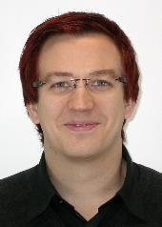
Self-portrait – Niko Kinnunen
Born: Kontiolahti, Finland, 1981.
Family: Wife, two very lively boys and a retired dog (Golden Retriever).
Studies in Kontiolahti
Elementary school -87 – -93
Lower secondary school -94 – -97
Higher secondary school -98 – -00
Studies at the University
Chemist researcher, MSc. studies -00 – -05
Doctoral studies, -06 – -11
”After the first chemistry class in secondary school, when teacher taught about structure of the atoms, I knew that I will be a chemist.”

Slide 10
Self-portrait – Niko Kinnunen
Interests
Referee in ice hockey
Fly-fishing
Chemistry and its application in practice

Slide 11
Employment history
Junior researcher – University of Eastern Finland 2006 - 2011
Research chemist – Ecocat Oy 2011 - 2013
Postdoctoral researcher – Itä-Suomen yliopisto 2014 –
Consultant in different development projects 2010 - 2014

Slide 12
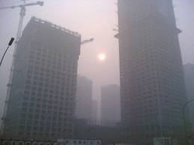
Motivation of product development chemist
Sunny day in New Delhi (lot of emissions)

Slide 13
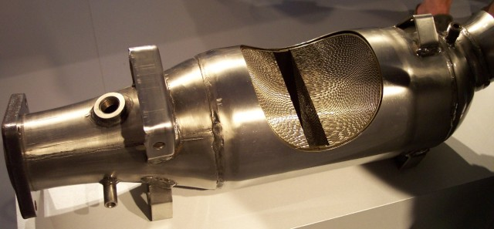
Developing catalysators
Heat of emissions makes the catalytic reactions in catalysator possible

Slide 14
Own study-path
Study-path is quite long - 24 years
Studying is not only reading, but also lost of friends and nice people!
The first challenge was to be admitted to higher secondary school
I thought that it will be very demanding challenge
The second and extreme challenge was to graduate from higher secondary school
Nobody in my family had not graduated from higher secondary school before me!
The third challenge was to get in to the University of Joensuu to study chemistry
This was my DREAM!!!
The fourth challenge was to get a doctoral degree
This was the most extreme challenge that I cannot ever achieve – I had reached the goal already – To be a chemist – But research was interesting and I set the new goal and dream – to have a doctoral degree some day!

Slide 15
Own study-path
How and why I started to study chemistry?
Eager and inspiring teacher at early stage in lower secondary school!
Desire to learn more
What was frightening me in studies at the university?
Studies in higher secondary school– In my opinion, I had the worse grades, but I thought: If I won´t try, I cannot achieve anything!
An idea about studying at the university – only the best students and genius may study at university!!!
Moving away from the family

Slide 16
Answers to students’ questions
What was the best at school?
Friends!
What was the hardest at school?
Rote learning
Subjects where I was good?
Crafts, IT, chemistry, and physics, if grades will be compared!
The hardest subjects at the school?
Swedish, geography, biology, and English, if grades will be compared!

Slide 17
Questions and answers
What was the hardest in chemistry?
I cannot know everything!
The best part of my job?
Working in laboratory and colleagues!
Motivation and how to maintain it?
Take small steps!
What kind of learner I am?
I am learning when I am doing things.
The most interesting thing what I have ever done?
Summer cottage, I did´t know what kind of project it will be, but I had a vision how it should look like.

Slide 18
Where chemist works?
University
Researcher
Community
Laboratories
Teacher
State
Finnish Environment Institute
The Finnish Defence Research Agency
VTT Technical Research Centre of Finland Ltd
National Bureau of Investigation
Private sector
Industry (Product developpemtn, Production, Quality and Environment
Research Institutes

Slide 19
Chemist in industry
Product development
Development of new products
Improving old products
Follow-up of law and applying it
Environment
Risk analysis ja prevention
Follow-up of emissions
Follow-up of law and applying it in practise
Production
Planning of production process
Follow-up of production process
Guiding of production
Follow-up of law and applying
Quality
Verifying the functionality of products
Verifying the validity of products
Follow-up of law and applying

Slide 20
Product development chemist as a part of group
Group may consist tenths or even hundreds of members
The group is divided in small groups and the result is finally assembled
Different type of people asre needed
The group makes the best result, when it consists of different personas.
Different sub-fields of science are represented
Chemistry
Physics
Engineering
Economics

Slide 21
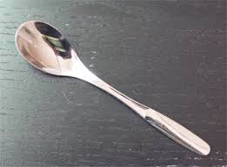
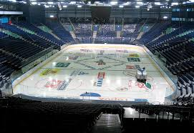
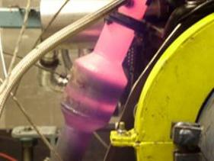
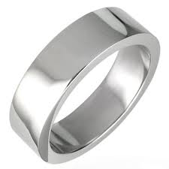
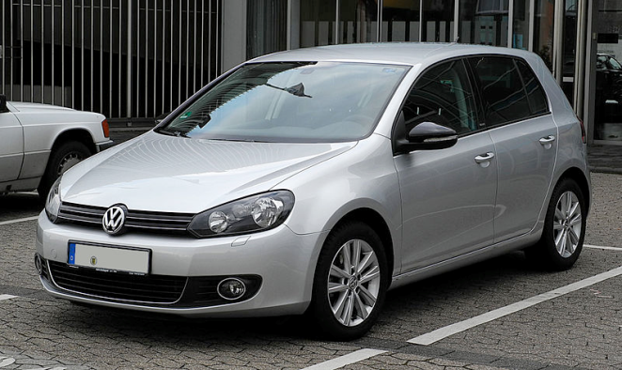
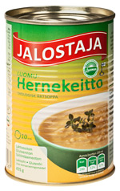
Everyday of product development chemist

