Slide 1
Zero plastics to landfills by 2020!
This project has received funding from the European Union’s Horizon 2020 research and innovation programme under grant agreement No 665100.

Slide 2
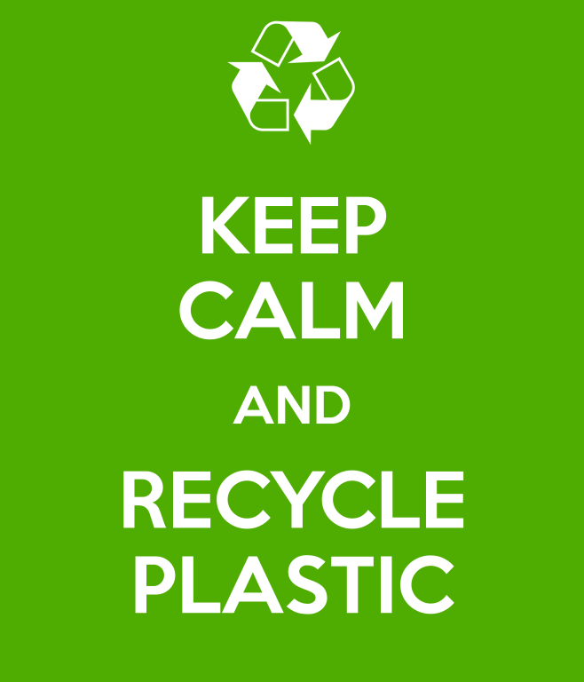
Zero plastics to landfills by 2020!
This project has received funding from the European Union’s Horizon 2020 research and innovation programme under grant agreement No 665100.

Slide 3
Notes:
The scenario is based on a comic related to an environmental issue – waste management (Parameter 1). The scenario refers to the twofold purpose of recycling when people receive money or goods in exchange for their recyclable wastes. This approach to recycle is a powerful motivation for people to start recycling (Parameter 2 – interesting for students) and students can start recycling campaigns.

Slide 5
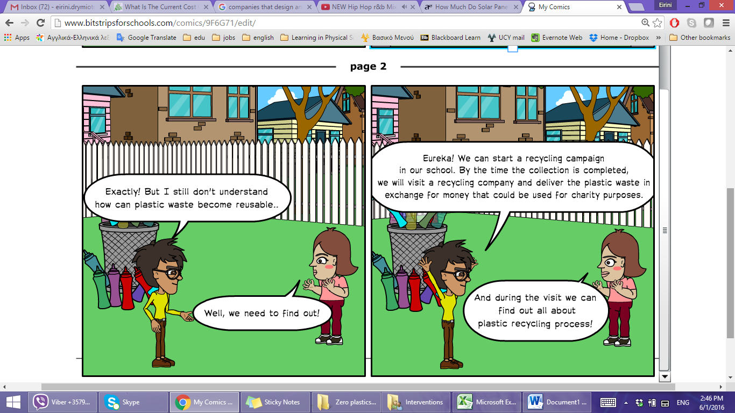
Notes:
Waste management is a global issue and recycle steps to the forefront. The question raised in the comic about the process of plastic recycling and how can plastic waste become reusable, links the scenario to the career aspect and industry (Parameter 1). Also, the scenario becomes personally relevant since students are called to take action and contribute to waste reduction (Parameter 3).

Slide 6
While visiting the 3MC recycling company…

Slide 7
Scientist- Recycling Company
Hello! My name is Mr.Green and I am working for the 3MC Company, a recycling company.
I am a Waste Management Engineer and I am mainly involved in the recycling process of plastic.

Slide 8
The recycling process of plastic waste
Could you please describe the recycling process of plastic waste?
Well, there are three main stages that should be considered for the plastic recycling.

Slide 9
Recycling process
1. Sorting
2. Baler/Shredding
3. Making pellets

Slide 10
1. Sorting
First of all, it’s the sorting of the plastic waste. Once the plastics are collected, they are sorted and divided into two categories, the soft and the hard plastic using a specially designed machine.

Slide 11
2. Baler/Shredding
The next step is to cut the plastics into tiny chunks or pieces.
During the second stage of the recycling process, the soft plastic is pressed in a machine. After that, it turns into a cube that can be sold as recycled material to industries.
However, the hard plastic, is transferred in the crushers as to be grinded and take the shape of a flake.

Slide 12
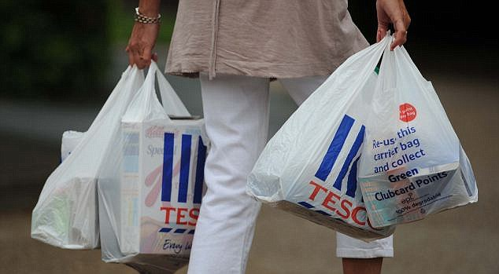
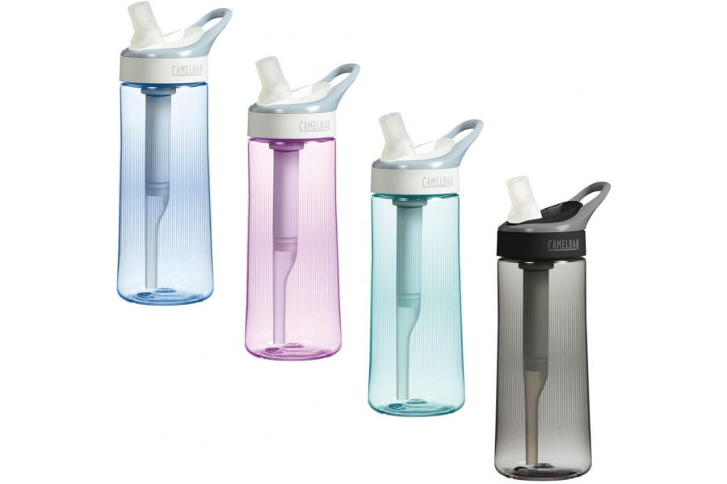
For example:
Soft plastics like Nylon could be pressed.
Hard plastics such as Beach beds, flasks and water bottles, are cut out and grinded

Slide 13
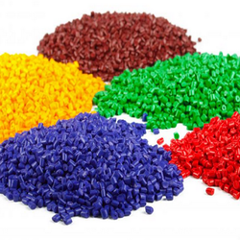
3. Making pellets
The last stage refers to the production of the final product. The soft pressed material or the hard crushed material can be melted and turned into pellets that are ready for reuse or be redesigned into new plastic products.

Slide 14
The scientist’s concern…
Of course! I think the most interesting but at the same time challenging stage is the sorting of the plastic waste. If something goes wrong with the sorting, the recycling process goes to waste!
Wow this is very interesting! Are there any challenges in this process?
In order to avoid this, there are some methods to identify the type of the plastic. This is the most demanding part of this stage and we should be very focus while doing that.

Slide 15
Of course. Every plastic has different characteristics but most of the times it is difficult to identify the type of the plastic. Usually the plastic is destroyed or dirty and it’s hard to read the name label that indicates the type of the plastic.
Could you please tell us more about the methods you use in order to identify the type of plastics?

Slide 16
Identification of plastic type
I use mainly two methods to check the type of plastic:
The first one is to combust the plastic. The fume, the smell and shape of the flame (i.e. flickering) can indicate the type of the plastic. If still I cannot identify the type of the plastic, then I implement the second method by putting the plastic into the water and see if it floats or sinks.

Slide 17
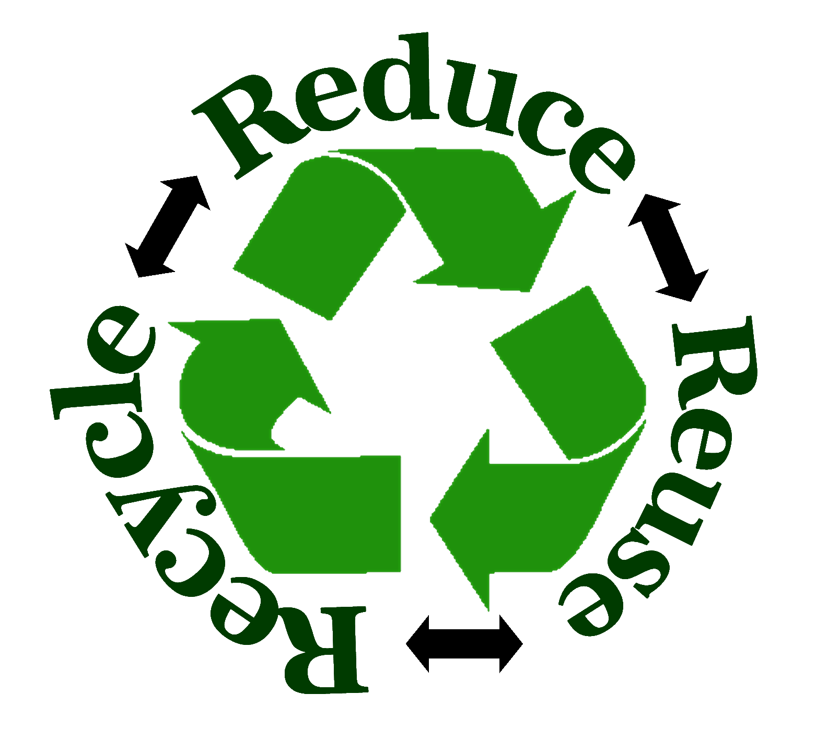
I have an idea! We could help Mr. Green sorting the plastic waste. Therefore, after having collected the plastic waste we could contribute in the second stage of plastic recycling process. We could identify the type of the plastic using the two methods proposed by Mr. Green: combustion or floating/sinking method.

