Slide 1
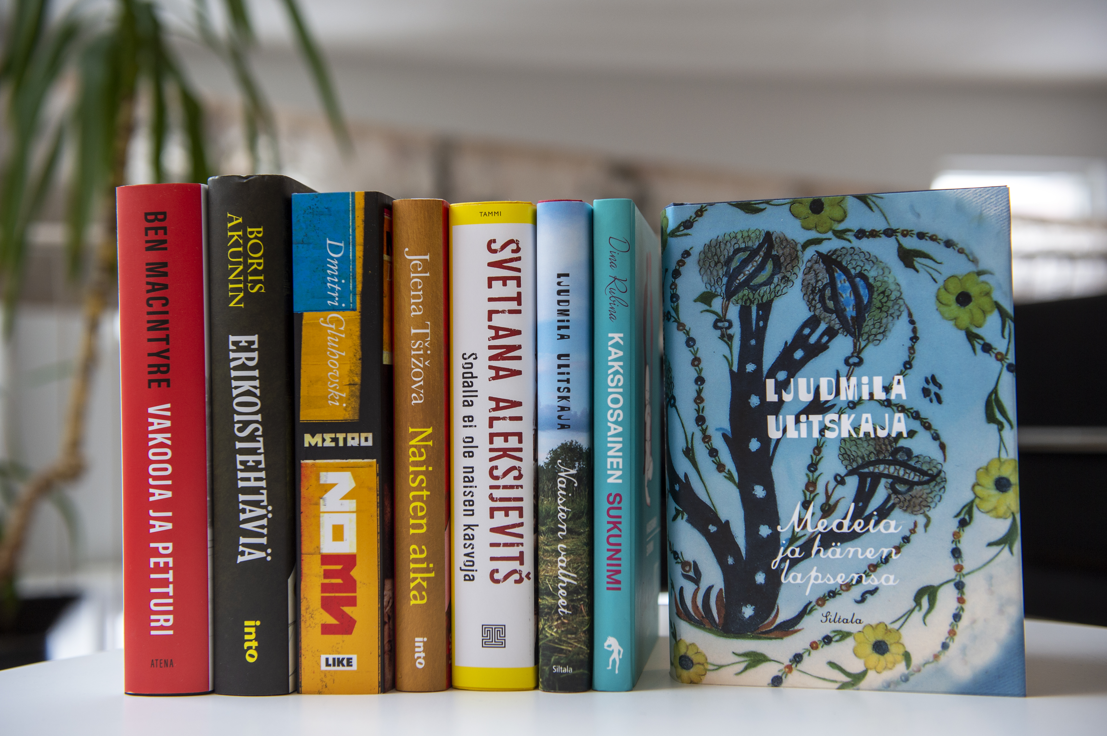
Russia in Finnish Translations
Research project (2022-24): the image of Russia in fiction and non-fiction translated into Finnish in the 2000s
Marja Sorvari // Nina Havumetsä // Erja Vottonen
Russian Language and Culture & Russian Language and Translation // School of Humanities, University of Eastern Finland
Background and objective of the study
The research project examines what kind of images of contemporary Russia are formed through the translations of fiction and non-fiction books into Finnish. This is a topical issue, given the significant changes in Russian society, culture and politics in the 21st century, especially in the 2010s. The project will provide new understanding about the following topics:
The themes of the translated works
Norms and expectations associated with translations from Russian (about Russia)
Reception of the translated works
The role of translation and publishing processes
Subproject 1
Marja Sorvari examines the images of Russia conveyed by works of fiction translated from Russian in the 2000s-2010s. What kind of texts are being translated and by which authors? Whose voices are heard in the works?
KUVA
Subproject 2
Nina Havumetsä examines what non-fiction literature on Russia has been translated into Finnish from Russian or other languages in the 2000s. What kind of Russia do these translations tell us about, and through whose eyes? The study examines the number of works, their themes and their place in the field of non-fiction on Russia.
Subproject 3
Erja Vottonen examines the translation and publishing processes, reception and images of fiction and non-fiction about Russia translated from Russian. What factors have influenced publishing decisions? What images do Finns have of Russian literature? The material consists of interviews with publishing house representatives and translators, book reviews and reader surveys.
CONTACT
marja.sorvari@uef.fi, nina.havumetsa@uef.fi, erja.vottonen@uef.fi
UNIVERSITY OF EASTERN FINLAND

